Slide 1
UNIT 3: Genetics-DNA vs. RNA
SB2Aa: Distinguish between DNA and RNA
How is the genetic code contained in DNA used to make proteins?
-The DNA code (original template) controls a cell’s activities by telling the cell which proteins to make.
There are 2 steps to making proteins:
WHEN? 1. Transcription and 2. Translation.

Slide 2
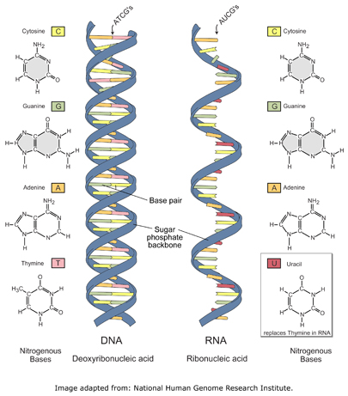
DNA VS. RNA
DNA BOTH RNA
1. Double stranded 1. nucleic 1. single stranded
2. A-T, C-G acids 2. A-U(uracil), C-G
3. Instructions for 2. nucleotides 3. recipe to make
life proteins
4. Deoxyribose 4. Ribose

Slide 3
Steps of transcription
1. Transcription--writing the recipe-RNA DNA→RNA (WHAT?)
An RNA(Ribonucleic acid) copy is made from a DNA strand
WHO?-DNA is the head chef and before his cooks can make the food on his menu, he has to write the recipes down!
WHO? DNA(Head chef) is stuck in the nucleus(office), so the recipes have to get delivered to the ribosome(kitchen)

Slide 4
tRANSCRIPTION
http://www.learnerstv.com/animation/animation.php?ani=326&cat=biology
WHO?-After the recipe is written, mRNA-the messenger, carries the coded information (recipe) from the nucleus and delivers the recipe to the ribosome.(WHAT?)
WHAT?-Once the recipe is delivered to the ribosome, it has to be followed by the cooks!

Slide 5
tRANSlaTION
How is the recipe going to be followed?
2. Translation-following the recipe
DNA--→RNA-→Protein (WHAT?)
Head chef→Recipe→Foods!
-mRNA has codons which are 3 letters that represent an amino acid (ingredient).(WHO?)

Slide 6
Codon charts
The Messenger RNA (mRNA) protein synthesis code
1st base | 2nd Base |  |  |  | 3rd Base
U | U | C | A | G
 | Phenylalanine | Serine | Tyrosine | Cysteine | U
 | Phenylalanine | Serine | Tyrosine | Cysteine | C
 | Leucine | Serine | Stop | Stop | A
 | Leucine | Serine | Stop | Tryptophan | G
C | Leucine | Proline | Histidine | Arganine | U
 | Leucine | Proline | Glutamine | Arganine | C
 | Leucine | Proline | Glutamine | Arganine | A
 | Leucine | Proline | Asparagine | Arganine | G
A | Isoleucine | Threonine | Asparagine | Serine | U
 | Isoleucine | Threonine | Lysine | Serine | C
 | Isoleucine | Threonine | Lysine | Arginine | A
 | Methionine; Start | Threonine | Aspartate | Arginine | G
G | Valine | Alanine | Aspartate | Glycine | U
 | Valine | Alanine | Aspartate | Glycine | C
 | Valine | Alanine | Glutamate | Glycine | A
 | Valine | Alanine | Glutamate | Glycine | G

Slide 7
Translation
WHO?-tRNA(transfer RNA) are the linecooks that follow the recipes to make the proteins(FOODS!)
WHAT? tRNA reads the codons with anticodons and drops off the correct amino acid.**Every 3 letters in the recipe calls for a different ingredient (amino acid)!
WHERE?-The recipe is translated at the ribosome(kitchen)
Amino acids bond together in the cytoplasm with peptide bonds to make a protein a.k.a. polypeptide)

Slide 8
Protein Synthesis
Nuclear
membrane
DNA
Transcription
mRNA
Ribosome
Translation
Protein

Slide 9
Protein synthesis
Let’s make a protein:
TRANSCRIPTION – copying the DNA instructions to make proteins into mRNA DNA→RNA
DNA strand - TCC GCG CAG
mRNA strand- ________ _________ _________
TRANSLATION – protein synthesis a.k.a. making a protein RNA-→Protein
amino acids - ___________ ________ __________

Slide 10
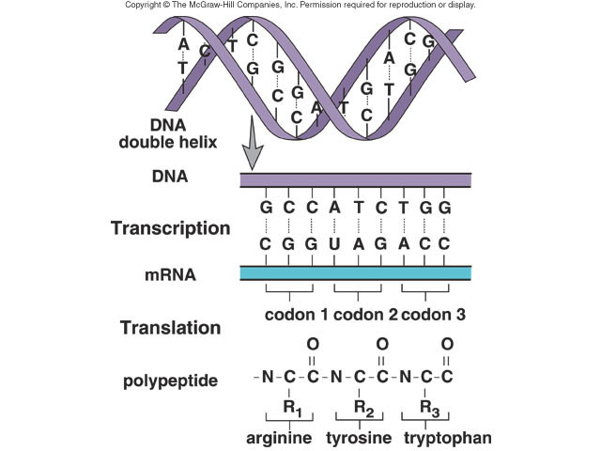
Transcription
Translation

