Slide 1
Warm-Up
Which of the following is not necessarily a distinct property of living things?
a. homeostasis
b. movement
c. metabolism
d. reproduction

Slide 2
Microscope Notes (Review)
Turn to page 11 in your IAN and take the following notes

Slide 3
Parts of the Microscope
1. Eyepiece (ocular lens)
Function: Magnifies (makes larger) the sample 10x
2. Stage
Function: Holds the slide in place
3. Diaphragm
Function: Varies (changes) the amount of light coming from the lamp
4. Coarse Adjustment
Function: The knob that focuses when using the low-power objective

Slide 4
Parts of the Microscope
5. Fine Adjustment
Function: The knob that focuses when using the medium and high-power objectives
6. Low-power (scanning) objective lens
Function: Magnifies the sample 4x
7. Medium-power objective lens
Function: Magnifies the sample 10x
8. High-power objectives lens
Function: Magnifies the sample 40x

Slide 5
Calculating TOTAL MAGNIFICATION
Eyepiece magnification x objective magnification = total magnification
Ex. 10x x 4x = 40x

Slide 6
Calculate the total magnification of the following:
eyepiece lens (5x) x low power objective (4x) = ___
eyepiece lens (10x) x high power objective (40x) = ___
eyepiece lens (7x) x medium power objective (10x) = ___
eyepiece lens (10x) x objective (45x) = ___
eyepiece lens (10x) x objective (50x) = ___

Slide 7
Calculate the objective power being used for viewing
eyepiece lens = 10x total magnification = 200x objective power = ____
eyepiece lens = 5x total magnification = 200x objective power = ____
eyepiece lens = 7x total magnification = 280x objective power = ____
eyepiece lens = 5x total magnification = 100x objective power = ____

Slide 8
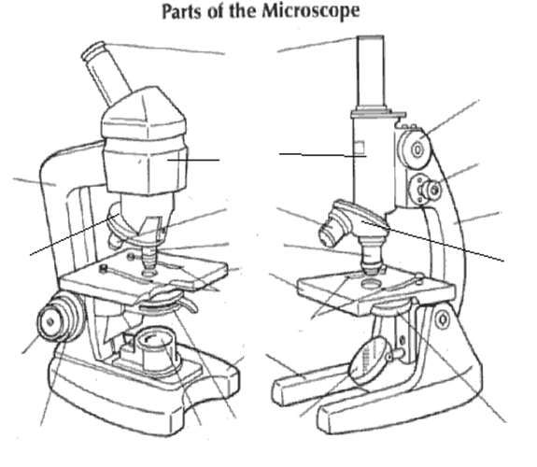
Label the Parts of the Microscope
Ocular Lens
“eyepiece
Complete the following handout
Coarse Adjustment
Fine Adjustment
ARM
Body Tube
ARM
Fine Adjustment
Diaphragm
Coarse Adjustment
Diaphragm

Slide 9
Label the Parts of the Microscope
Complete the following handout
Coarse Adjustment
Fine Adjustment
Body Tube
Revolving Nosepiece
Revolving Nosepiece
Stage
Fine Adjustment
Base
Light Source
Light Source
Diaphragm
Coarse Adjustment
Diaphragm

Slide 10
Label the Parts of the Microscope
Complete the following handout
Coarse Adjustment
Fine Adjustment
Low Objective
Revolving Nosepiece
Revolving Nosepiece
Stage Clips
Fine Adjustment
Base
Light Source
Light Source
Diaphragm
Coarse Adjustment
Diaphragm

Slide 11
Label the Parts of the Microscope
Complete the following handout
Coarse Adjustment
Fine Adjustment
Revolving Nosepiece
Revolving Nosepiece
High Objective
Fine Adjustment
Base
Light Source
Light Source
Coarse Adjustment

Slide 12
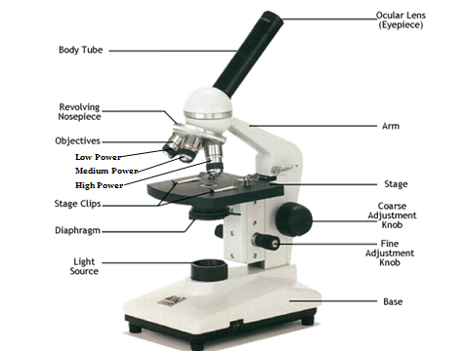
Labeled Microscope

Slide 13
Microscope Lab (Practice)
Using page 13 in your IAN
Select 4 slides and draw each image at
Label Each Image Properly
Low power
Medium Power
High Power
Slide Name | Low (4x) | Medium (10x) | High (40x)
Granulum examplar

Slide 14
Unit 1 Study Guide
Using your IAN Complete the Study Guide

Slide 15
CLOSING
How does Lab Safety improve the “scientific method?”
3 complete sentences

Slide 16
Homework
Have Your Syllabus Signed by a parent or guardian.
Study for the Unit 1 Test
Complete the Kleenex Box assignment

