Slide 1
Warm-Up page 25 IAN
Water consist of what 2 elements?
Is water considered organic?

Slide 2
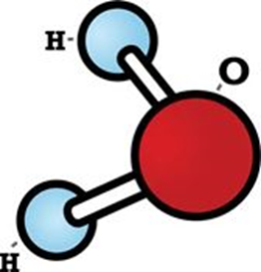
Warm-Up page 25 IAN
Water consist of what 2 elements?
H (Hydrogen)
O (Oxygen)
Is water considered organic?
NO

Slide 3
Opening
Molecules Gone Wild

Slide 4
Macromolecule Quiz
Open your IAN to Biochemistry Notes on page 21
Take 10 minutes to review your notes
Make sure your name and block are on your paper

Slide 5
Water Notes Page 25 IAN What is the structure of water and why is it so important for life?

Slide 6
Water
WATER (chemical formula : H₂O)
Why is water so important for the survival of all organisms?
It covers about 75%of the Earth’s surface.
About 2/3( 66% ) of the human body is made
of water.
Water is able to ABSORB large amounts of heat, so
lakes and oceans stabilize LAND & AIR temperatures.

Slide 7
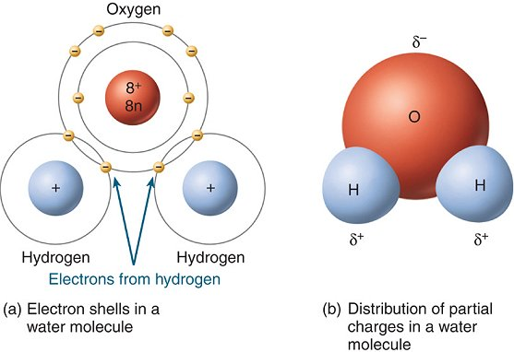
Water
Water is a polar molecule
- What does this mean? One end of the molecule is +, the other is more -
- This means water has the ability to attract ions and other polar(charged) molecules. (+, -)
Mickey
mouse!

Slide 8
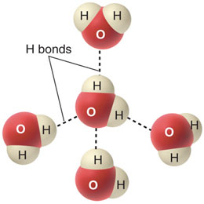
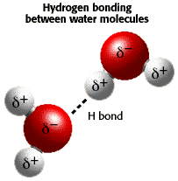
Water
- Water molecules also attract other WATER molecules. The + ends of one water molecule are attracted to the - ends of another water molecule, which creates a third type of bond called a HYDROGEN bond.
- This polarity of water contributes to the 6 properties of water, which make water one of the most important substances to organisms.

Slide 9
The 6 properties of water
1. Water has a High Surface Tension
- The POLAR attraction between water molecules causes the TOP layer of water molecules to act like a STRETCHED film over the surface of water. This property is called SURFACE TENSION.

Slide 10
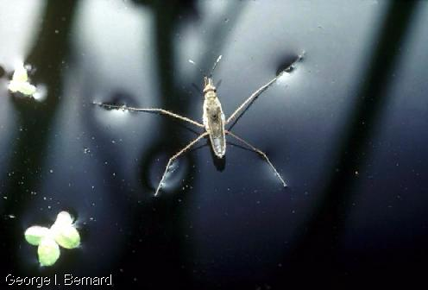
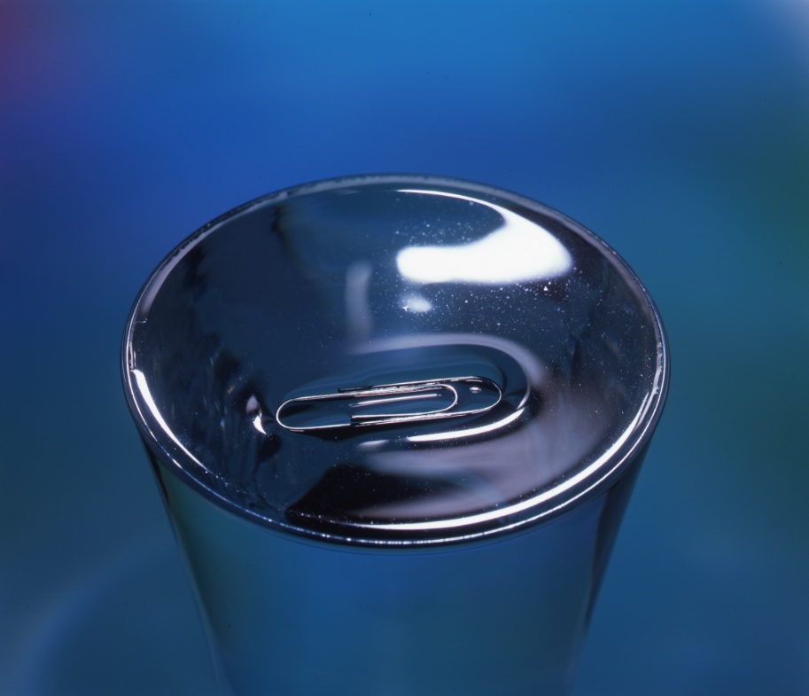
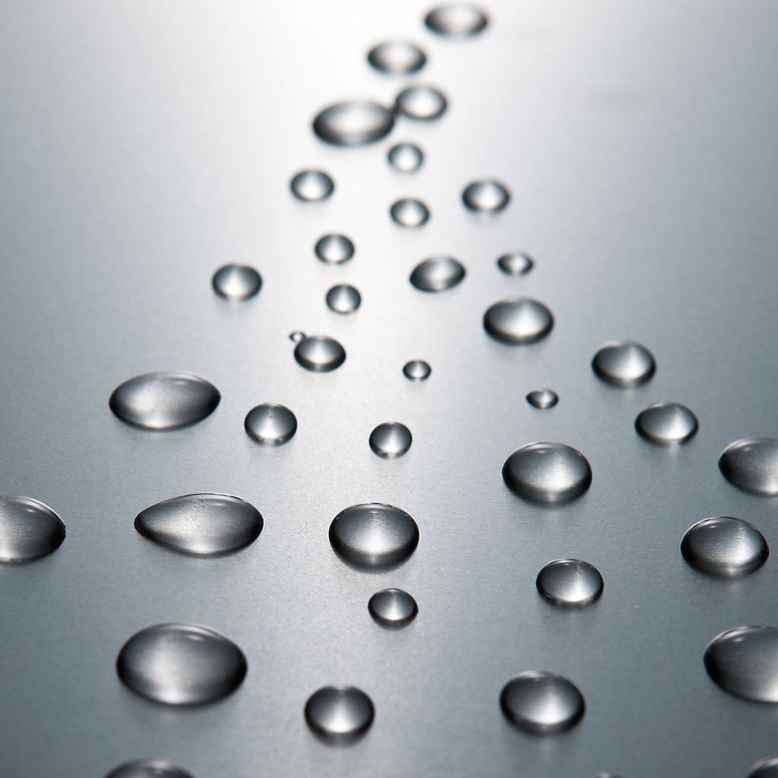
Surface Tension
Ex. Over filled glass, water
Strider and droplets
water strider

Slide 11
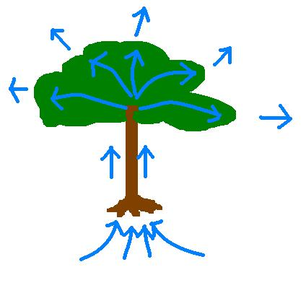
The 6 properties of water
2. Water has Capillary Action
- Water will move UPWARDS in the very thin tubes found in the roots and stems of plants so that water and nutrients can be delivered throughout the entire plant.

Slide 12
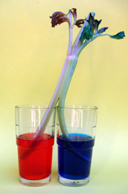
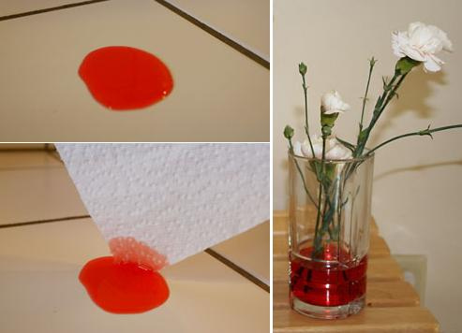
Capillary Action

Slide 13
The 6 properties of water
3. Water has a High Heat of Vaporization
- It takes A LOT of energy to make water evaporate because water molecules are strongly attracted to one another.
- Water carries heat with it when it evaporates, which allows organisms to get rid of excess heat, which cools them off.

Slide 14
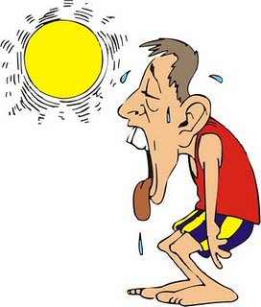
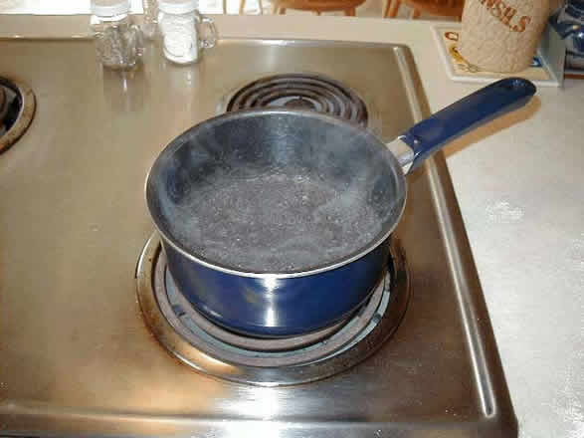
High Heat of Vaporization

Slide 15
The 6 properties of water
4. Water Resists Temperature Change
- It takes a lot of heat to increase the temperature of water
- Water also has to lose a lot of heat before it can cool
- Therefore, water does not like to change temperature.

Slide 16
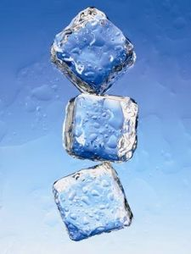
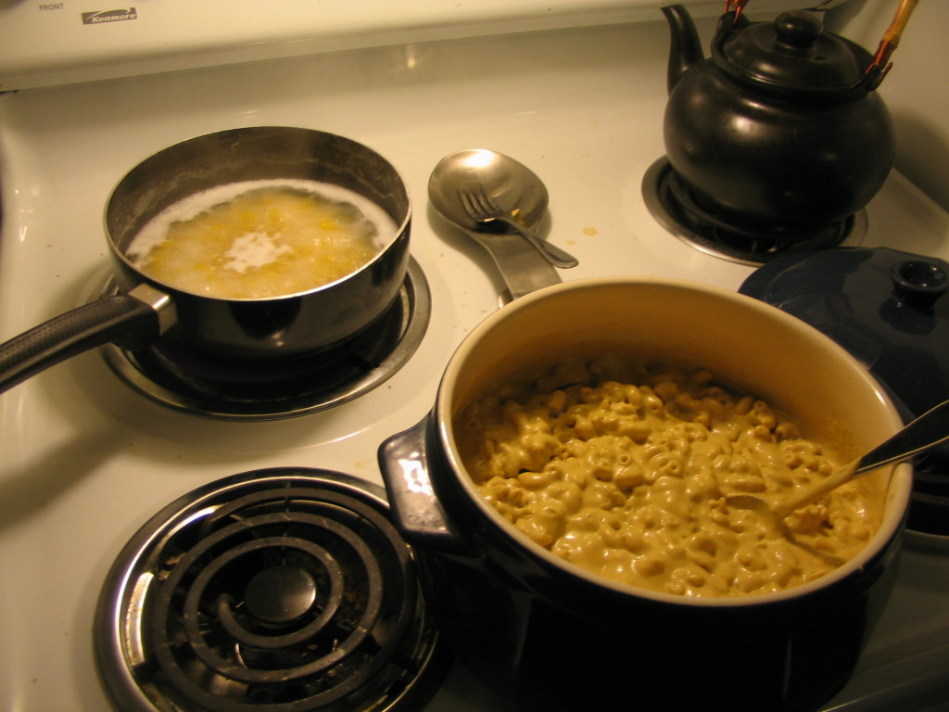
Water resists temperature change

Slide 17
The 6 properties of water
5. Water Expands when it Freezes
- Water’s solid form, ice, floats because it has a lower density than the liquid form of water. Ice is less dense than liquid water.
- Why is this so important to organisms living in lakes, ponds, rivers, streams, and oceans?

Slide 18
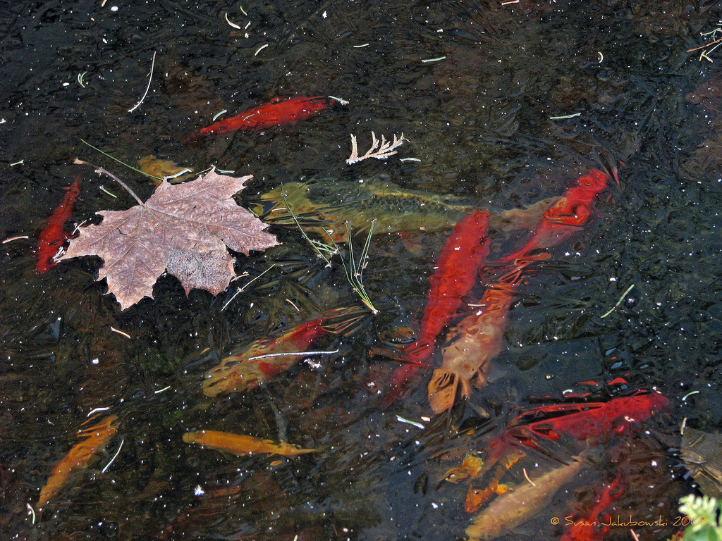
Water Expands when it Freezes

Slide 19
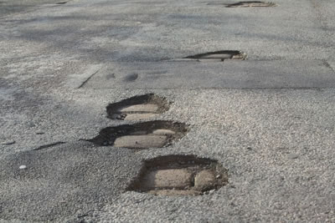
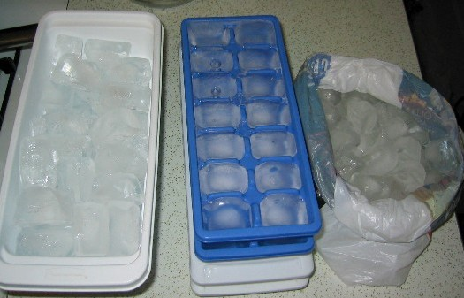
Water Expands when it Freezes
POTHOLES!
ICE TRAYS

Slide 20
The 6 properties of water
6. Water is the Universal Solvent
- Water is able to absorb many substances, so the water inside and outside of cells can carry nutrients into and around cells.
- Water also carries wastes away from cells.

Slide 21
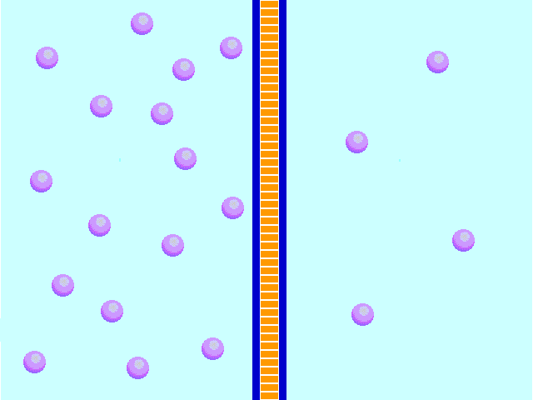
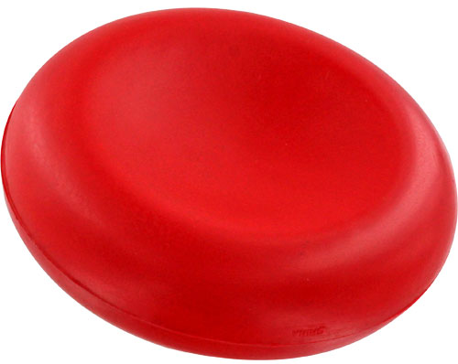
Water is the Universal Solvent
Nutrients Wastes
RED BLOOD CELL

Slide 22
Summary
Complete the summary;
Make sure key words such a polar, properties and solvent are used.

