Slide 1
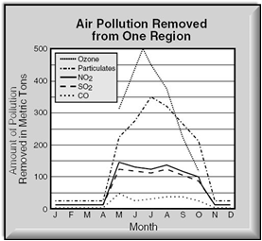
Warm Up
Look at the graph, identify the IV and DV “justify your answer”

Slide 2
IAN Update TOC
Page 1- Syllabus Page 2 -IAN Procedures Page 3- Bioglyph Page 4- Multiple Intelligence Inventory (yellow) Page 5- Unit 1 Divider (microscope, Scientific Method, Characteristics of Life ect.) Page 6- What Every Graph Must Have Page 7- Graphing Practice Page 8- Characteristics of Life (Notes) Page 9- Characteristics of Life (Activity) Page 10- Scientific Method (Notes) & Picking Out the Parts of the Experiment (handout) Page 11: Microscope Notes Page 12 Microscope Parts (handout) Page 13 Microscope Lab Page 14 Unit 1 Study Guide

Slide 3
Think-Tac-Know
Each Student will complete 2 possible “wins”
This means you must answer 5 out of 9 questions on you TTK placemat.
You are REQUIRED to answer the Center Question
All question should be written in sentence format with correct spelling.
You will attach your answers to the placemat and turn them in at the end of the class period.

Slide 4
Compare & Contrast Sexual to Asexual Reproduction | List the 8 Characteristics of Living Things and give an example of each. | Explain how “lab safety can be beneficial to the scientific method.”
Write a scenario for the 6 steps of scientific method. | Using your text book complete the following questions on page | Compare and Contrast an quantitative and qualitative data; give an example of each
Label the parts of an Microscope (get sheet from Ms. Thomas) | Define the terms : independent variable, dependent variable and constant and controls. | Complete the graphing activity (see Ms. Thomas)
A

Slide 5
Define the terms : independent variable, dependent variable and constant and controls | List the 8 Characteristics of Living Things and give an example of each. | Explain how “lab safety can be beneficial to the scientific method.”
Complete the graphing activity (see Ms. Thomas) | Using your text book complete the following questions on page | Compare and Contrast an quantitative and qualitative data; give an example of each
Label the parts of an Microscope (get sheet from Ms. Thomas) | Compare & Contrast Sexual to Asexual Reproduction (include examples) | Write a scenario for the 6 steps of scientific method.
B

Slide 6
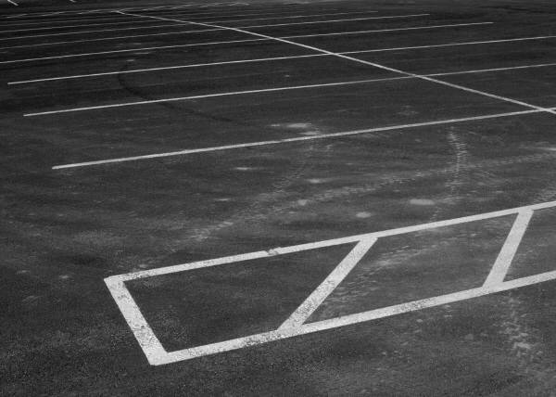
Closing/Parking Lot
Using your post-it write down a question that you would like reviewed before the test on Friday

