Slide 1
Warm-up
What is the significance of a scientific notebook?

Slide 2
SCIENTIFIC METHOD
Opening
Examples of Scientific Notebooks
Hint: Quiz Wednesday

Slide 3
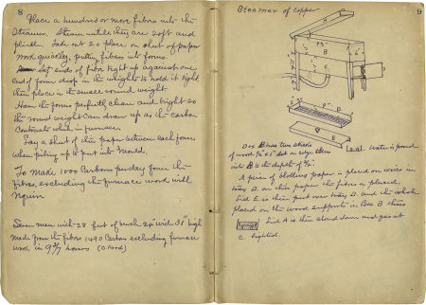

Slide 4
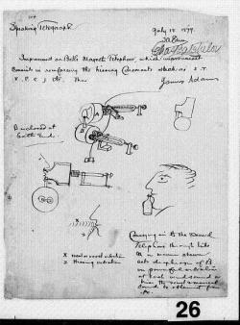

Slide 5
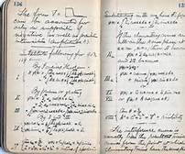

Slide 6
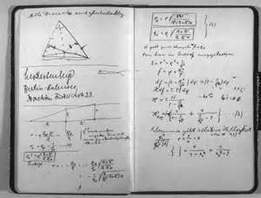

Slide 7
The Steps a scientist uses to solve a problem
State the problem.
- usually in the form of a question
Background research
- collect information about the problem
Hypothesis
- an educated answer to the problem
-Should be in the format: If…then…

Slide 8
Parts of an experiment
4. Experiment
- A procedure that tests the hypothesis
An experiment includes:
a) Independent variable (IV) is the one variable that is changed by the scientist. The IV is plotted on the x-axis of a graph.
b) Dependent variable (DV) is the variable being measured. The DV is the result of the change of the IV.
- The DV is plotted on the y-axis of a graph.
c) Control is the group that remains unchanged. It’s used to compare the results of the experimental group and is usually the ‘normal’ conditions
d) Constants are all factors in an experiment that are kept the same. Constants make the experiment fair.

Slide 9
The final steps
5. Data/Results
- collect & record data observed in the experiment
- results can be qualitative (descriptive) or quantitative (numerical)
6. Conclusion
- Ask yourself, “Does the data support my hypothesis? Why or why not?
- Be aware of experimental and human errors.

Slide 10
What is theory?
- theory: something that is considered to be true repeatedly

Slide 11
Practice (whole Group)

Slide 12
Work Session
Independent Practice: Work on “your own quietly”

Slide 13
Closing
Summarize your notes and “turn in your work”

Slide 14
PRACTICE SCENARIO
To determine the effect of ammonium sulfate on plant growth, two seed flats containing soil from a lawn were seeded using standard lawn grass mixture. One flat was watered with rainwater and the other with rainwater containing a little ammonium sulfate. The flats were kept in the same area to ensure identical conditions and temperature.
DEPENDENT VARIABLE
INDEPENDENT VARIABLE
CONSTANT
CONTROL

Slide 15
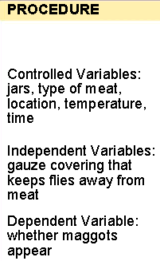
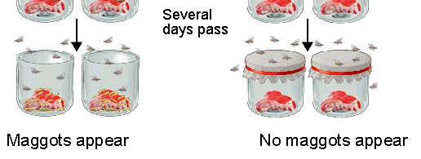
REDI’S EXPERIMENT ON SPONTANEOUS GENERATION

