Slide 1
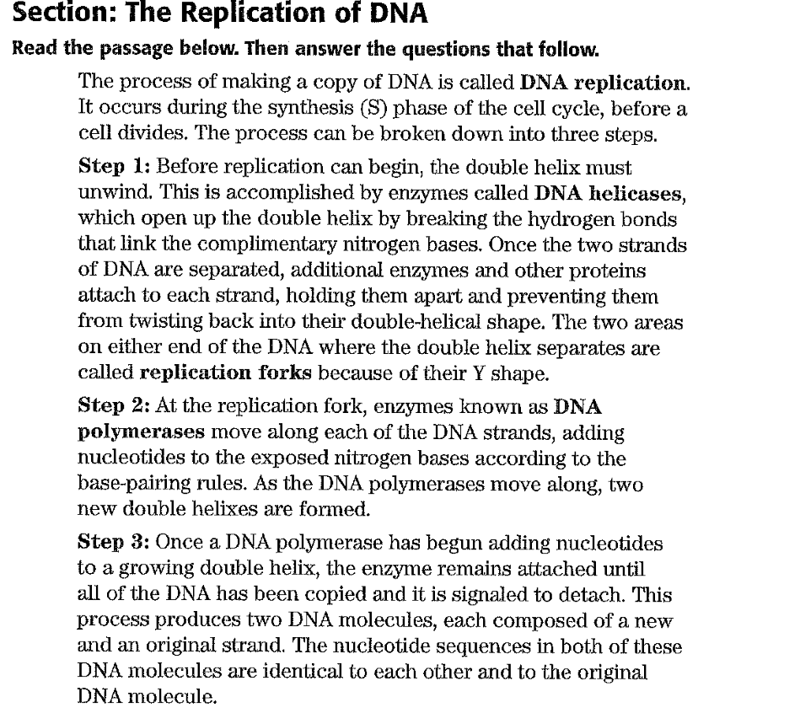
Warm Up

Slide 2
Warm Up
The process of making a copy of DNA
During the S phase of the cell cycle, before the cell divides

Slide 3
Warm Up
The complementary DNA strand must unwind, the hydrogen bonds must be broken
DNA helicase –unwinds DNA breaks the bonds between the nucleotides
2 identical strands are formed, both identical to parent strand. (DNA polymerase releases)
DNA polymerase-adds nucleotides at the replication fork

Slide 4
Warm up
Enzymes are types of Proteins,
Proteins are Macromolecules or Polymers made up of
Monomer-Amino Acids
They speed up chemical reactions
They usually end with the suffix -ase

Slide 5
The Role of RNA
Protein Synthesis: SB2. Obtain, evaluate, and communicate information to analyze how genetic information is expressed in cells.
a. Construct an explanation of how the structures of DNA and RNA lead to the expression of information within the cell via the processes of replication, transcription, and translation

Slide 6
What is RNA?
RNA = Ribonucleic Acid
RNA is a messenger between DNA and the ribosomes (site of protein synthesis).
RNA serves to decode DNA.

Slide 7
RNA
Base Pairing:
Adenine (A) pairs with Uracil (U).
Cytosine (C) pairs with Guanine (G).
Shape:
Single Stranded
Type of Sugar:
Ribose

Slide 8
CODONS
Monomers for Protein: Amino Acids
Codon = 3 letter “words” that make up DNA and RNA
Examples:
DNA Codons: ACG TTT AGA CGG
RNA Codons: AUC GUU CAC UUU

Slide 9
There are 3 types of RNA:
mRNA
tRNA
rRNA

Slide 10
mRNA
Messenger RNA (mRNA): decodes the message from the DNA
Sends the message to the ribosome

Slide 11
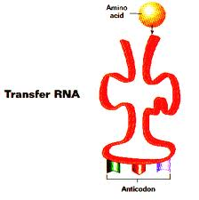
tRNA
Transfer RNA (tRNA): carries amino acids to ribosomes where they join together to form proteins (a.k.a. polypeptides).
tRNA is the RNA associated with the proteins.

Slide 12
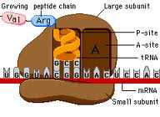
rRNA
Ribosomal RNA (rRNA) is the majority of ribosomal makeup.
Holds tRNA to mRNA.

Slide 13
Two Steps to Make a Protein DNA → RNA → Protein
Step 1: Transcription
Step 2: Translation
DNA → RNA (mRNA)
The process where DNA is copied into mRNA
Once copied, mRNA leaves the nucleus and goes out into the cytoplasm to a ribosome
RNA (mRNA) → Protein
The process where RNA is converted into proteins
How?
1) the ribosome reads the mRNA codons
2) tRNA brings the correct amino acid
3) amino acids are joined together to make a protein

Slide 14
mRNA Codons Join the Ribosome
Large
subunit
P
Site
A
Site
mRNA
A
U
G
C
U
A
C
U
U
C
G
Small subunit

Slide 15
Initiation
aa2
aa1
2-tRNA
1-tRNA
G
A
U
anticodon
U
A
C
hydrogen
bonds
A
U
G
C
U
A
C
U
U
C
G
A
codon
mRNA

Slide 16
Elongation
peptide bond
aa3
aa1
aa2
3-tRNA
G
A
A
1-tRNA
2-tRNA
anticodon
U
A
C
G
A
U
hydrogen
bonds
A
U
G
C
U
A
C
U
U
C
G
A
codon
mRNA

Slide 17
aa1
peptide bond
aa3
aa2
1-tRNA
U
A
C
3-tRNA
(leaves)
G
A
A
2-tRNA
G
A
U
A
U
G
C
U
A
C
U
U
C
G
A
mRNA
Ribosomes move over one codon

Slide 18
peptide bonds
aa1
aa4
aa2
aa3
4-tRNA
G
C
U
2-tRNA
3-tRNA
G
A
U
G
A
A
A
U
G
C
U
A
C
U
U
C
G
A
A
C
U
mRNA

Slide 19
peptide bonds
aa1
aa4
aa2
aa3
2-tRNA
4-tRNA
G
A
U
(leaves)
G
C
U
3-tRNA
G
A
A
A
U
G
C
U
A
C
U
U
C
G
A
A
C
U
mRNA
Ribosomes move over one codon

Slide 20
peptide bonds
aa5
aa1
aa2
aa4
aa3
5-tRNA
U
G
A
3-tRNA
4-tRNA
G
A
A
G
C
U
G
C
U
A
C
U
U
C
G
A
A
C
U
mRNA

Slide 21
peptide bonds
aa5
aa1
aa2
aa3
aa4
5-tRNA
3-tRNA
U
G
A
G
A
A
4-tRNA
G
C
U
G
C
U
A
C
U
U
C
G
A
A
C
U
mRNA
Ribosomes move over one codon

Slide 22
aa5
aa4
aa199
Termination
aa3
primary
structure
of a protein
aa200
aa2
aa1
terminator
or stop
codon
200-tRNA
A
C
U
C
A
U
G
U
U
U
A
G
mRNA

Slide 23
End Product –The Protein!
The end products of protein synthesis is a primary structure of a protein
A sequence of amino acid bonded together by peptide bonds
aa5
aa4
aa3
aa2
aa199
aa1
aa200

Slide 24
Codon Charts
The Messenger RNA (mRNA) protein synthesis code
1st base | 2nd Base |  |  |  | 3rd Base
U | U | C | A | G
 | Phenylalanine | Serine | Tyrosine | Cysteine | U
 | Phenylalanine | Serine | Tyrosine | Cysteine | C
 | Leucine | Serine | Stop | Stop | A
 | Leucine | Serine | Stop | Tryptophan | G
C | Leucine | Proline | Histidine | Arganine | U
 | Leucine | Proline | Glutamine | Arganine | C
 | Leucine | Proline | Glutamine | Arganine | A
 | Leucine | Proline | Asparagine | Arganine | G
A | Isoleucine | Threonine | Asparagine | Serine | U
 | Isoleucine | Threonine | Lysine | Serine | C
 | Isoleucine | Threonine | Lysine | Arginine | A
 | Methionine; Start | Threonine | Aspartate | Arginine | G
G | Valine | Alanine | Aspartate | Glycine | U
 | Valine | Alanine | Aspartate | Glycine | C
 | Valine | Alanine | Glutamate | Glycine | A
 | Valine | Alanine | Glutamate | Glycine | G

