Slide 1
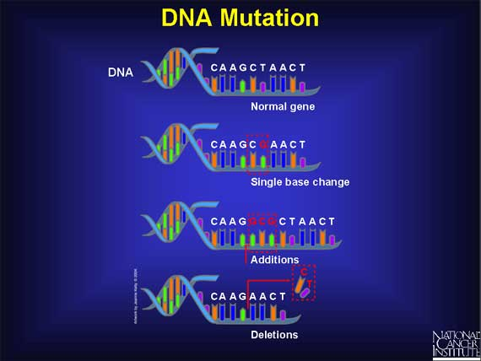
UNIT 3: DNA and RNA What is a mutation and how does it cause changes in organisms?
A mutation is a change in a nitrogenous base sequence (order) of a gene. (Gene – a particular sequence of your DNA that occupies a specific location on a chromosome and determines a particular characteristic)

Slide 2
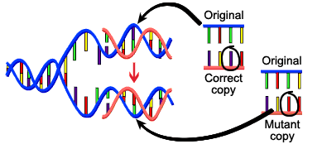
Mutations
When the base sequence of a gene is changed, the amino acid sequence of the protein is also changed (Remember: amino acids are monomers of a protein)

Slide 3
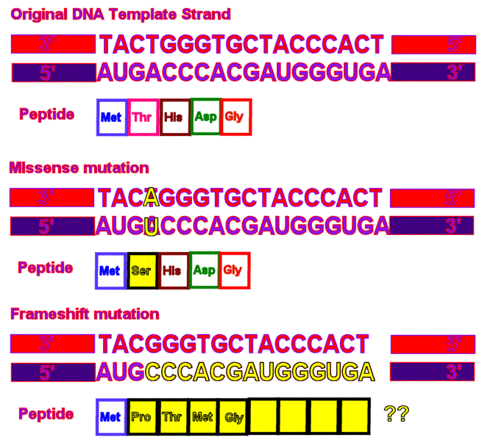
Mutations
A change in an amino acid sequence in a protein may affect its shape (conformation), which could result in a change in the protein’s function.

Slide 4
Mutations
Examples of Mutations:
Replace G with A: Substitution Mutation
Point Mutation
mRNA codons
A
A U G A A G U U U A G C G C A U U G U A A

Slide 5
Mutations
Examples of Mutations:
Replace G with A: Substitution Mutation
Point Mutation
mRNA codons
A U A A A G U U U A G C G C A U U G U A A
U A U U U C A A A U C G C G U A A C A U U
tRNA anticodons

Slide 6
Mutations
The above mutation changes the mRNA codons, which changes the amino acid, which then changes the whole protein.

Slide 7
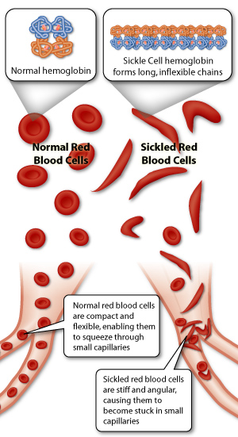
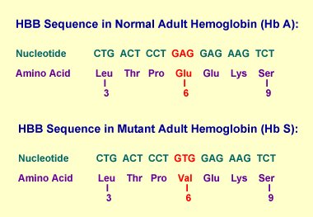
Sickle Cell Anemia

Slide 8
Deletion of U- Frame shift mutation
mRNA codons
A U G A A G U U G G C G C A U U G U A A
U C U U C A A C C G C G U A A C A U
tRNA anticodons

Slide 9
Mutations
The above mutation changes every amino acid in the protein AFTER the addition or deletion because the whole mRNA strand shifts.
DNA--→RNA-→Protein
Change in the DNA→Change in the RNA→Change in the Protein!

Slide 10
Mutations can be:
GOOD!
BAD!
Cause no harmful effects at all!
Chromosomal Mutations:
Four main types:
1. Deletion-
ABC•DEF AC•DEF
2. Duplication-
ABC•DEF ABBC•DEF
3. Inversion-
ABC•DEF AED•CBF
4. Translocation-
AB•CD + EF•GH AB•GH + EF•CD

