Slide 1
Warm-Up
Explain why it is important to use Lab Safety?
Give me 2 examples

Slide 2
Make Your Own Symbol
Using your “text book” and a partner
Create your own “Safety Symbol
Pages XXVII-XXXI

Slide 3
Microscope Notes
Turn to page 11 in your IAN and take the following notes

Slide 4
Parts of the Microscope
1. Eyepiece (ocular lens)
Function: Magnifies (makes larger) the sample 10x
2. Stage
Function: Holds the slide in place
3. Diaphragm
Function: Varies (changes) the amount of light coming from the lamp
4. Coarse Adjustment
Function: The knob that focuses when using the low-power objective

Slide 5
Parts of the Microscope
5. Fine Adjustment
Function: The knob that focuses when using the medium and high-power objectives
6. Low-power (scanning) objective lens
Function: Magnifies the sample 4x
7. Medium-power objective lens
Function: Magnifies the sample 10x
8. High-power objectives lens
Function: Magnifies the sample 40x

Slide 6
Calculating TOTAL MAGNIFICATION
Eyepiece magnification x objective magnification = total magnification
Ex. 10x x 4x = 40x

Slide 7
Calculate the total magnification of the following:
eyepiece lens (5x) x low power objective (4x) = ___
eyepiece lens (10x) x high power objective (40x) = ___
eyepiece lens (7x) x medium power objective (10x) = ___
eyepiece lens (10x) x objective (45x) = ___
eyepiece lens (10x) x objective (50x) = ___

Slide 8
Calculate the objective power being used for viewing
eyepiece lens = 10x total magnification = 200x objective power = ____
eyepiece lens = 5x total magnification = 200x objective power = ____
eyepiece lens = 7x total magnification = 280x objective power = ____
eyepiece lens = 5x total magnification = 100x objective power = ____

Slide 9
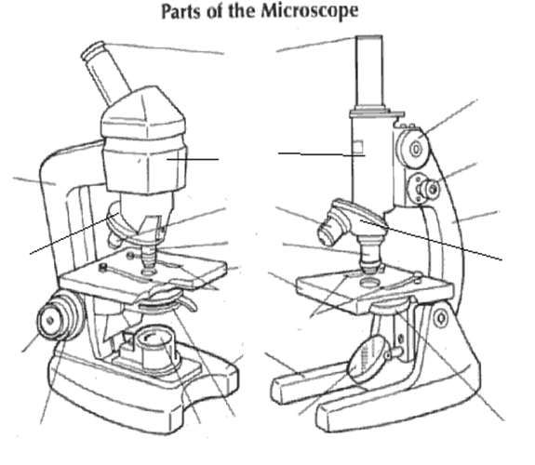
Label the Parts of the Microscope
Complete the following handout

Slide 10
Microscope Lab (Practice)
Using page 12 in your IAN
Select 4 slides and draw each image at
Label Each Image Properly
Low power
Medium Power
High Power

Slide 11
CLOSING
How does Lab Safety improve the “scientific method?”
3 complete sentences

