Slide 1
Warm-Up Quiz !
The _____________________always goes on the X-axis.

Slide 2
Warm-Up Quiz !
T or F Independent Variable: the one factor that can be changed by the scientist.______

Slide 3
Warm-Up Quiz !
The dependent variable goes on the Y-axis._____

Slide 4
Warm-Up Quiz !
4-9. Write the 6 steps of scientific Method

Slide 5
What are the 8 characteristics of Living Things

Slide 6
What every graph must have:
REVIEW
1. Title- describe the data shown
Ex. Amount of Rainfall in the Hudson Valley
2. Labels AND Units on each axis
3. Axis Intervals- the scale must be uniform
Count by 2s, 3s, 5s, 10s, 20s (whichever fits your data the best)
4. Data Points:
Line Graph-connect data points
If there are multiple sets of data on one graph make a LEGEND (key)
Bar Graph-shade in the bars

Slide 7
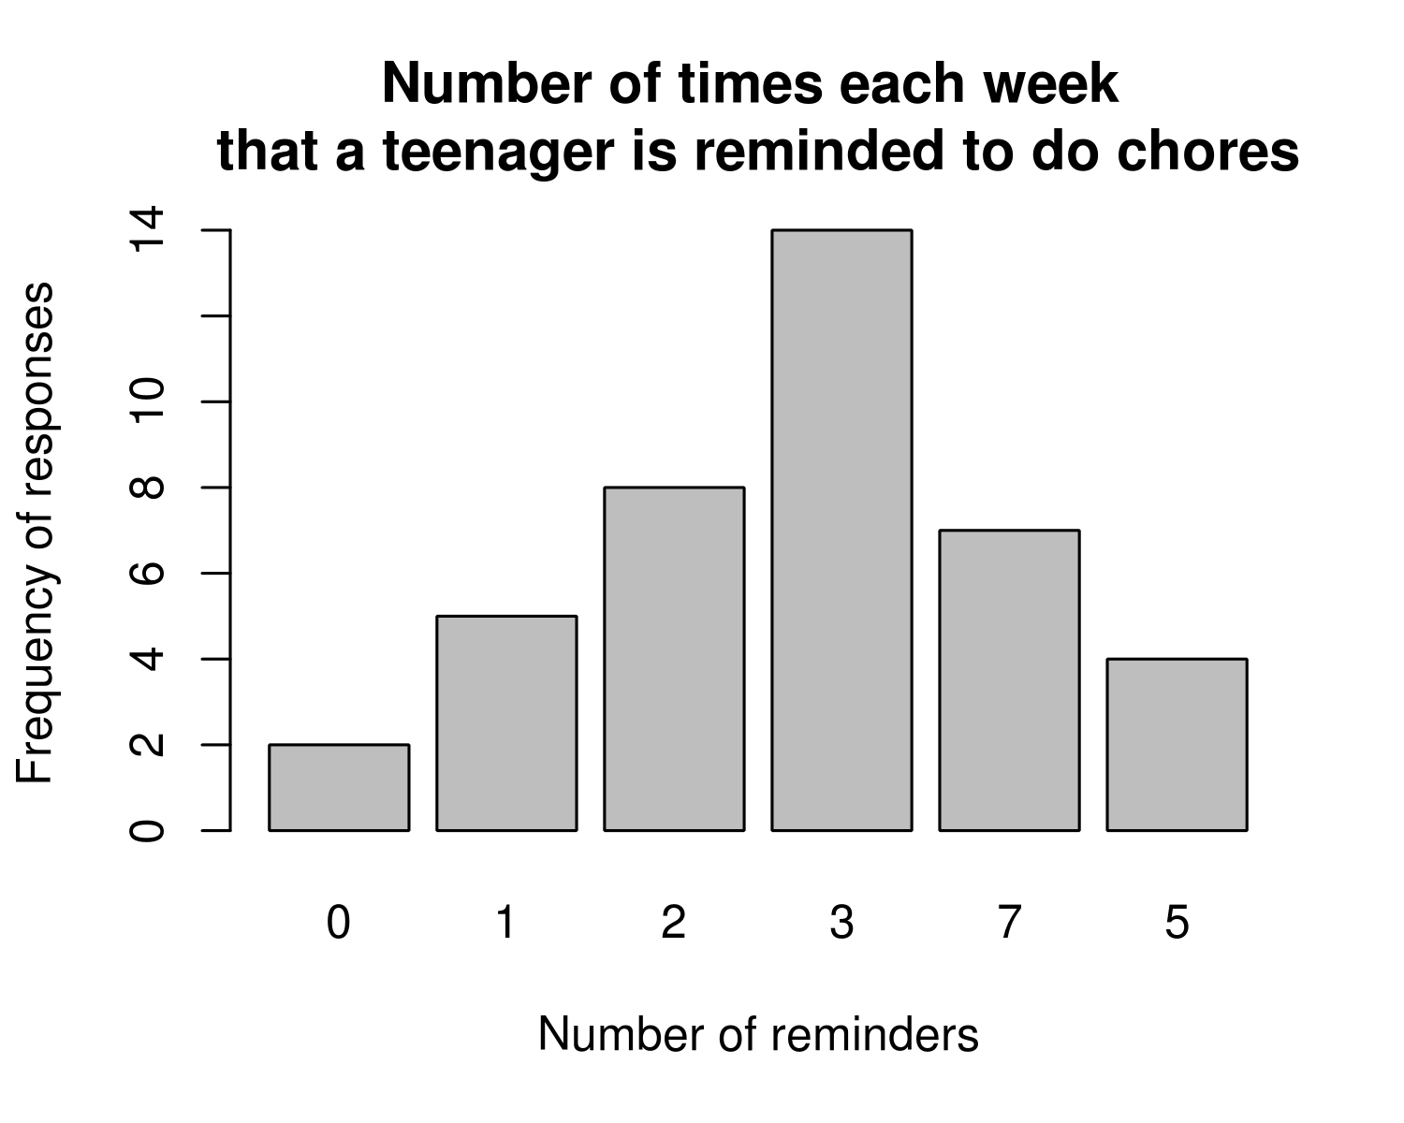
Title
Data of the number of students pets

Slide 8
Title
Data of the number of students pets
Labels and Units

Slide 9
Title
Data of the number of students pets
Axis Intervals-
Labels and Units

Slide 10
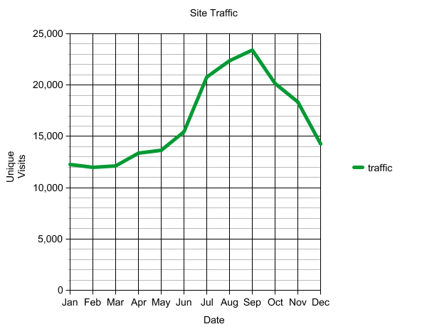
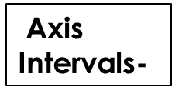
Title
Data of the number of students pets
Axis Intervals-
Labels and Units

Slide 11
Which axis?
The independent variable always goes on the X-axis.
Independent Variable: the one factor that can be changed by the scientist.
The dependent variable goes on the Y-axis.
Dependent Variable: the factor being measured in the experiment.

Slide 12
Graphing Practice
Use the following data to make a line graph about the effect of exercise on heart rate:
Time (mins) | Heart Rate (bpm) Person A | Heart Rate (bpm) Person B
0 | 70 | 65
5 | 85 | 76
15 | 120 | 90
20 | 135 | 110
35 | 150 | 130

