Slide 1
Genetics Test Review
Test Date
Friday
March 28, 2015
Introduction
Notes:
Animated open book effect
(Difficult)
Tip: You will need to use drawing guides and the ruler to position the objects on this slide.
To display the drawing guides and the ruler, do the following:
On the Home tab, in the Slides group, click Layout, and then click Blank.
Right-click the slide background area, and then click Grid and Guides. In the Grid and Guides dialog box, under Guide settings, select Display drawing guides on screen. (Note: One horizontal and one vertical guide will display on the slide at 0.00, the default position. The spine of the book will be aligned to the vertical drawing guide.)
On the View tab, in the Show/Hide group, select Ruler.
To reproduce the first shape in the Book cover group on this slide, do the following:
On the Home tab, in the Drawing group, click Shapes, and then under Rectangles click Rounded Rectangle (second option from the left). On the slide, drag to draw a rounded rectangle.
Select the rounded rectangle. Under Drawing Tools, on the Format tab, in the Size group, do the following:
In the Shape Height box, enter 4.5”.
In the Shape Width box, enter 3.33”.
On the rounded rectangle, drag the yellow diamond adjustment handle to the left to decrease the amount of rounding on the corners.
On the Home tab, in the bottom right corner of the Drawing group, click the Format Shape dialog box launcher. In the Format Shape dialog box, click Fill in the left pane, select Gradient fill in the Fill pane, and then do the following:
In the Type list, select Linear.
Click the button next to Direction, and then click Linear Right (first row, fourth option from the left).
In the Angle box, enter 0°.
Under Gradient stops, click Add gradient stops or Remove gradient stops until two stops appear in the slider.
Also under Gradient stops, customize the gradient stops that you added as follows:
Select the first stop in the slider, and then do the following:
In the Position box, enter 0%.
Click the button next to Color, and then under Theme Colors, click Red, Accent 2, Darker 50% (sixth row, sixth option from the left).
Select the second stop in the slider, and then do the following:
In the Position box, enter 100%.
Click the button next to Color, and then under Theme Colors, click Red, Accent 2, Darker 25% (fifth row, sixth option from the left).
Also in the Format Shape dialog box, click Line Color in the left pane. In the Line Color pane, select No line.
Also in the Format Shape dialog box, click 3-D Format in the left pane, and then in the 3-D Format pane, do the following:
Under Bevel, click the button next to Top, and then under Bevel click Circle (first row, first option from the left). Next to Top, in the Width box, enter 4 pt, and in the Height box, enter 4 pt.
Under Surface, click the button next to Material, and then under Standard click Warm Matte (second option from the left).
Also under Surface, click the button next to Lighting, and then under Neutral, click Three Point (first row, first option from the left).
On the slide, drag the rounded rectangle until the left edge is against the vertical drawing guide.
On the Home tab, in the Drawing group, click Arrange, point to Align, and then do the following:
Click Align to Slide.
Click Align Middle.
To reproduce the second shape in the Book cover group on this slide, do the following:
On the Home tab, in the Clipboard group, click the arrow under Paste, and then click Duplicate.
On the slide, drag the duplicate rectangle until the left edge is against the vertical drawing guide.
On the Home tab, in the Drawing group, click Arrange, point to Align, and then do the following:
Click Align to Slide.
Click Align Middle.
Under Drawing Tools, on the Format tab, in the Size group, in the Shape Width box, enter 0.73”.
On the Home tab, in the bottom right corner of the Drawing group, click the Format Shape dialog box launcher. In the Format Shape dialog box, click Fill in the left pane, select Gradient fill in the Fill pane, and then do the following:
In the Type list, select Linear.
Click the button next to Direction, and then click Linear Left (first row, fifth option from the left).
In the Angle box, enter 180°.
Under Gradient stops, click Add gradient stops or Remove gradient stops until two stops appear in the slider.
Also under Gradient stops, customize the gradient stops that you added as follows:
Select the first stop in the slider, and then do the following:
In the Position box, enter 0%.
Click the button next to Color, and then under Theme Colors, click Black, Text 1 (first row, second option from the left).
In the Transparency box, enter 50%.
Select the second stop in the slider, and then do the following:
In the Position box, enter 100%.
Click the button next to Color, and then under Theme Colors, click Black, Text 1 (first row, second option from the left).
In the Transparency box, enter 100%.
Also in the Format Shape dialog box, click 3-D Format in the left pane. In the 3-D Format pane, under Bevel, click the button next to Top, and then under No Bevel, click None.
To reproduce the third shape (first small rectangle on the book spine) in the Book cover group on this slide, do the following:
Select the first, larger rectangle on the slide. On the Home tab, in the Clipboard group, click the arrow to the right of Copy, and then click Duplicate.
Select the third, duplicate rectangle. Under Drawing tools, on the Format tab, in the Size group, do the following:
In the Shape Height box, enter 0.08”.
In the Shape Width box, enter 0.73”.
On the Home tab, in the bottom right corner of the Drawing group, click the Format Shape dialog box launcher. In the Format Shape dialog box, click Fill in the left pane, select Gradient fill in the Fill pane, and then do the following:
In the Type list, select Linear.
Click the button next to Direction, and then click Linear Diagonal (first row, third option from the left).
In the Angle box, enter 135°.
Also in the Format Shape dialog box, click 3-D Format in the left pane, and then in the 3-D Format pane, do the following:
Under Bevel, next to Top, in the Width box, enter 3 pt, and in the Height box, enter 3 pt.
Under Surface, click the button next to Lighting, and then under Neutral click Soft (first row, third option from the left).
To reproduce the rest of the shapes (other small rectangles on the book spine) in the Book cover group on this slide, do the following:
Select the third, smaller rectangle.
On the Home tab, in the Clipboard group, click the arrow to the right of Copy, and then click Duplicate. Repeat this process for a total of four thin, rounded rectangles.
To position the four thin, rounded rectangles on the book spine, do the following:
Drag the first rectangle 1.75” above the horizontal drawing guide, with the left edge touching the vertical drawing guide.
Drag the second rectangle 0.75” above the horizontal drawing guide, with the left edge touching the vertical drawing guide.
Drag the third rectangle 0.75” below the horizontal drawing guide, with the left edge touching the vertical drawing guide.
Drag the fourth rectangle 1.75” below the horizontal drawing guide, with the left edge touching the vertical drawing guide.
On the Home tab, in the Editing group, click Select, and then click Select All.
On the Home tab, in the Drawing group, click Arrange, and then click Group.
On the Home tab, in the Editing group, click Select, and then click Selection Pane.
On the Selection and Visibility pane, double-click the group to edit the name, and then enter Book cover.
To reproduce the first shape in the Inside-left pages group on this slide, do the following:
On the Home tab, in the Drawing group, click Shapes, and then under Rectangles click Rounded Rectangle (second option from the left). On the slide, drag to draw a rounded rectangle.
Under Drawing Tools, on the Format tab, in the Size group, do the following:
In the Shape Height box, enter 4.5”.
In the Shape Width box, enter 3.33”.
On the rounded rectangle, drag the yellow diamond adjustment handle to the left to decrease the amount of rounding on the corners.
On the Home tab, in the bottom right corner of the Drawing group, click the Format Shape dialog box launcher. In the Format Shape dialog box, click Fill in the left pane, select Gradient fill in the Fill pane, and then do the following:
In the Type list, select Linear.
Click the button next to Direction, and then click Linear Left (first row, fifth option from the left).
In the Angle box, enter 180°.
Under Gradient stops, click Add gradient stops or Remove gradient stops until two stops appear in the slider.
Also under Gradient stops, customize the gradient stops that you added as follows:
Select the first stop in the slider, and then do the following:
In the Position box, enter 0%.
Click the button next to Color, and then under Theme Colors, click Red, Accent 2, Darker 50% (sixth row, sixth option from the left).
Select the second stop in the slider, and then do the following:
In the Position box, enter 100%.
Click the button next to Color, and then under Theme Colors, click Red Accent 2, Darker 25% (fifth row, sixth option from the left).
Also in the Format Shape dialog box, click Line Color in the left pane, and then in the Line Color pane, select No line.
On the slide, drag the rectangle until the right edge is against the vertical guideline.
On the Home, tab, in the Drawing group, click Arrange, point to Align, and then do the following:
Click Align to Slide.
Click Align Middle.
To reproduce the second shape in the Inside-left pages group on this slide, do the following:
On the Home tab, in the Drawing group, click Shapes, and then under Rectangles click Rectangle (first option from the left). On the slide, drag to draw a rectangle.
Under Drawing Tools, on the Format tab, in the Size group, do the following:
In the Shape Height box, enter 4.33”.
In the Shape Width box, enter 3.15”.
On the Home tab, in the bottom right corner of the Drawing group, click the Format Shape dialog box launcher. In the Format Shape dialog box, click Fill in the left pane, select Gradient fill in the Fill pane, and then do the following:
In the Type list, select Linear.
Click the button next to Direction, and then click Linear Left (first row, fifth option from the left).
In the Angle box, enter 180°.
Under Gradient stops, click Add gradient stops or Remove gradient stops until five stops appear in the slider.
Also under Gradient stops, customize the gradient stops that you added as follows:
Select the first stop in the slider, and then do the following:
In the Position box, enter 0%.
Click the button next to Color, and then under Theme Colors, click White, Background 1, Darker 35% (fifth row, first option from the left).
Select the second stop in the slider, and then do the following:
In the Position box, enter 5%.
Click the button next to Color, and then under Theme Colors, click White, Background 1 (first row, first option from the left).
Select the third stop in the slider, and then do the following:
In the Position box, enter 18%.
Click the button next to Color, and then under Theme Colors, click White, Background 1, Darker 5% (second row, first option from the left).
Select the fourth stop in the slider, and then do the following:
In the Position box, enter 38%.
Click the button next to Color, and then under Theme Colors, click White, Background 1 (first row, first option from the left).
Select the fifth stop in the slider, and then do the following:
In the Position box, enter 93%.
Click the button next to Color, and then under Theme Color,s click White, Background 1 (first row, first option from the left).
Also in the Format Shape dialog box, click Line Color in the left pane, and then in the Line Color pane, select No line.
Also in the Format Shape dialog box, click Shadow in the left pane. In the Shadow pane, click the button next to Presets, under Outer click Offset Right (second row, first option from the left), and then do the following:
In the Transparency box, enter 60%.
In the Size box, enter 100%.
In the Blur box, enter 4 pt.
In the Angle box, enter 0°.
In the Distance box, enter 3 pt.
On the slide, drag the rectangle until the right edge touches the vertical drawing guide.
On the Home tab, in the Drawing group, click Arrange, point to Align, and then do the following:
Click Align to Slide.
Click Align Middle.
Press and hold CTRL, and then in the Selection and Visibility task pane, select the rectangle and the rounded rectangle to the left of the vertical drawing guide.
On the Home tab, in the Drawing group, click Arrange, and then click Group.
In the Selection and Visibility task pane, double-click the new group to edit the name, and then enter Inside-left pages.
To reproduce the first shape in the Inside-right pages with text group, do the following:
In the Selection and Visibility task pane, select the Inside-left pages group.
On the Home tab, in the Clipboard group, click the arrow to the right of Copy, and then click Duplicate.
On the Home tab, in the Drawing group, click Arrange, point to Rotate, and then click More Rotation Options. In the Size and Position dialog box, on the Size tab, under Size and rotation, in the Rotation box, enter 180°.
In the Selection and Visibility task pane, double-click the new group to edit the name, and then enter Inside-right pages.
On the slide, drag the rectangle until the left edge is against the vertical drawing guide.
On the Home, tab, in the Drawing group, click Arrange, point to Align, and then do the following:
Click Align to Slide.
Click Align Middle.
To reproduce the text effects in the Inside-right pages with text group, do the following:
On the Insert tab, in the Text group, click Text Box, and then on the slide, drag to draw a text box.
Enter text in the text box, and then select the text. (Note: To reproduce the example above, enter Introduction.) On the Home tab, in the Font group, do the following:
In the Font list, select Vivaldi.
In the Font Size list, select 18.
On the Home tab, in the Paragraph group, click Center to center the text in the text box.
On the slide, drag the text box until the left edge of the text is 1” to the right of the vertical drawing guide and the bottom edge of the text is 0.5” above the horizontal drawing guide.
To reproduce the page edges in the Inside-right pages with text group, do the following:
On the Home tab, in the Drawing group, click Shapes, and then under Lines click Line (first option from the left).
On the slide, press and hold SHIFT, and then drag to draw a straight, vertical line.
Select the line. Under Drawing Tools, on the Format tab, in the Size group, in the Shape Width box, enter 4.32”.
Under Drawing Tools, on the Format tab, in the Shape Styles group, click the arrow next to Shape Outline, and then under Theme Colors, click White, Background 1, Darker 15% (third row, first option from the left).
On the Home tab, in the Clipboard group, click the arrow to the right of Copy, and then click Duplicate. Repeat this process for a total of six lines.
On the slide, drag the six lines until they are bunched together in a dense group, no wider than 0.5”.
In the Selection and Visibility task pane, press and hold CTRL, and then select all six straight connectors (lines).
On the Home tab, in the Drawing group, click Arrange, point to Align, and then do the following:
Point to Align, and then click Align Selected Objects.
Point to Align, and then click Distribute Horizontally.
Point to Align, and then click Align Middle.
Click Group.
On the slide, drag the group of lines until the right edge of the group of lines is touching the right edge of the white rectangle to the right of the vertical drawing guide.
On the Home tab, in the Drawing group, click Arrange, point to Align, and then do the following:
Click Align to Slide.
Click Align Middle.
In the Selection and Visibility task pane, press and hold CTRL, and then select the group of lines, the text box, and the Inside-right pages group.
On the Home tab, in the Drawing group, click the arrow under Arrange, and then click Group.
In the Selection and Visibility task pane, double-click the new group to edit the name, and then enter Inside-right pages with text.
To reproduce the animation effects on this slide, do the following:
In the Selection and Visibility pane, select the Book cover group. On the Home tab, in the Drawing group, click Arrange, and then click Bring to Front.
In the Selection and Visibility pane, select the Inside-left pages group. On the Home tab, in the Drawing group, click Arrange, and then click Bring Forward.
In the Selection and Visibility pane, select the Book cover group. On the Animations tab, in the Advanced Animation group, click Add Animation, point to Exit, and then click More Exit Effects. In the Add Exit Effect dialog box, under Basic, click Wipe.
On the Animations tab, in the Timing group, do the following:
In the Start list, select With Previous.
In the Duration box, enter 1.00 second.
Also on the Animations tab, in the Animation group, click Effect Options, and then click From Right.
In the Selection and Visibility pane, select the Inside-left pages group. On the Animations tab, in the Advanced Animation group, lick Add Animation, point to Entrance, and then click More Entrance Effects. In the Add Entrance Effect dialog box, under Basic, click Wipe.
On the Animations tab, in the Timing group, do the following:
In the Start list, select After Previous.
In the Duration box, select 1.00 seconds.
Also on the Animations tab, in the Animation group, click Effect Options, and then click From Right.
To reproduce the background effects on this slide, do the following:
Right-click the slide background area, and then click Format Background. In the Format Background dialog box, click Fill in the left pane, select Gradient fill in the Fill pane, and then do the following:
In the Type list, select Linear.
Click the button next to Direction, and then click Linear Down (first row, second option from the left).
Under Gradient stops, click Add gradient stops or Remove gradient stops until two stops appear in the slider.
Also under Gradient stops, customize the gradient stops that you added as follows:
Select the first stop in the slider, and then do the following:
In the Position box, enter 63%.
Click the button next to Color, and then under Theme Colors, click Black, Text 1 (first row, second option from the left).
Select the second stop in the slider, and then do the following:
In the Position box, enter 100%.
Click the button next to Color list, and then under Theme Colors, click Black, Text 1, Lighter 50% (second row, second option from the left).

Slide 2
Standard
SB2

Slide 3
Genetics Study Guide
Question 1-7
SB2a

Slide 4
Genetics Study Guide
1. What is the sequence in a DNA molecule that determines the proteins to be produced?

Slide 5
Genetics Study Guide
What is the sequence in a DNA molecule that determines the proteins to be produced?
nucleotides

Slide 6
Genetics Study Guide
What is A DNA molecule that is produced by combining DNA from different sources or organisms is called?

Slide 7
Genetics Study Guide
What is A DNA molecule that is produced by combining DNA from different sources or organisms is called?
Recombinant DNA

Slide 8
Genetics Study Guide
3. Know what types of genetic code can be found in RNA.

Slide 9
Genetics Study Guide
4. What type of RNA acts like a delivery truck, delivers amino acids to the ribosome for protein synthesis, and then leaves empty again, to go collect another amino acid?

Slide 10
Genetics Study Guide
What type of RNA acts like a delivery truck, delivers amino acids to the ribosome for protein synthesis, and then leaves empty again, to go collect another amino acid?
Transfer RNA

Slide 11
Genetics Study Guide
5. What are the characteristics of RNA?

Slide 12
Genetics Study Guide
What are the characteristics of RNA?
Four bases, single stranded, ribose for 5 carbon sugar, phosphate group

Slide 13
Genetics Study Guide
What are the characteristics of RNA?
Four bases, single stranded, ribose for 5 carbon sugar, phosphate group

Slide 14
Genetics Study Guide
6.How are DNA & RNA different?

Slide 15
Genetics Study Guide
6.How are DNA & RNA different?
DNA-double stranded, RNA- single stranded
DNA- deoxyribose, RNA-ribose,
RNA-uracil, DNA- thymine

Slide 16
Genetics Study Guide
7. What base is found in RNA but not in DNA?

Slide 17
Genetics Study Guide
7. What base is found in RNA but not in DNA?
uracil

Slide 19
Genotype vs. Phenotype
Phenotype
Genotype
Genetic Combinations
Represented by the two letters in each box of a Punnett Square
Ex. TT, Tt, tt
Expressed on the gene (Genes are segments of chromosomes)
Physical traits
What you can see with your eyes
Ex. Brown, green, tall

Slide 20
Allele
Forms of gene
Example (s):
Gene: Hair Color Gene: Flower Color
Alleles: Alleles:
Brown Purple
Blonde White
Black Pink
Red

Slide 21
Dominant vs. Recessive Allele
Seen in 1st Generation
Hides the recessive allele
Example:
Tall is dominant over short
We “write” the dominant alleles with a capital letter (T)
Seen in the 2nd Generation
Hidden by the dominant allele
Example:
Tall is dominant over short
We “write” the recessive alleles with a lower case letter (t)

Slide 22
Heterozygous vs. Homozygous
Hetero = different
Different alleles
Ex. Bb, Gg, Ff, Tt
Homo =
same
Same alleles
Ex. BB, HH, aa, kk, gg

Slide 23
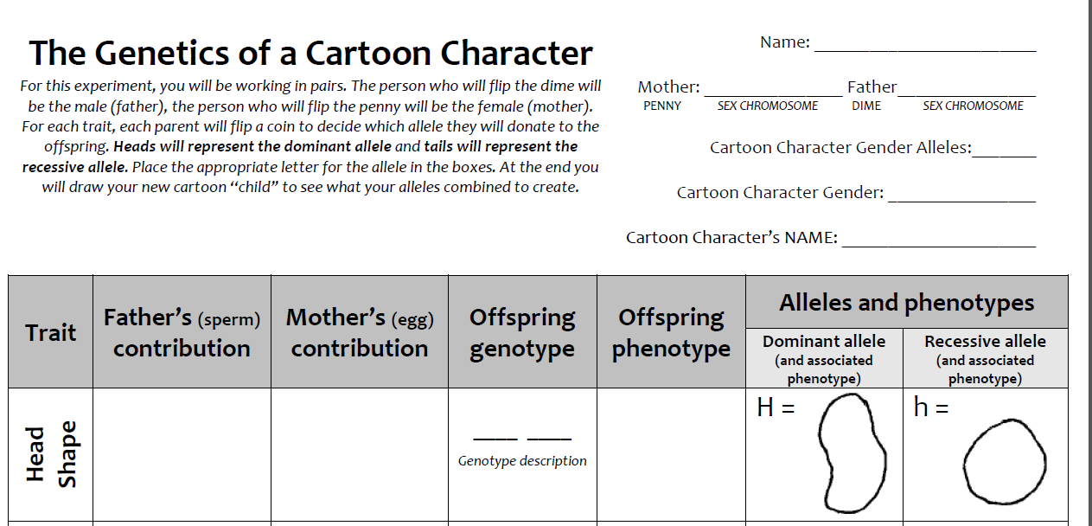
Genetics of a Cartoon Character (I Do)
We Do

Slide 24
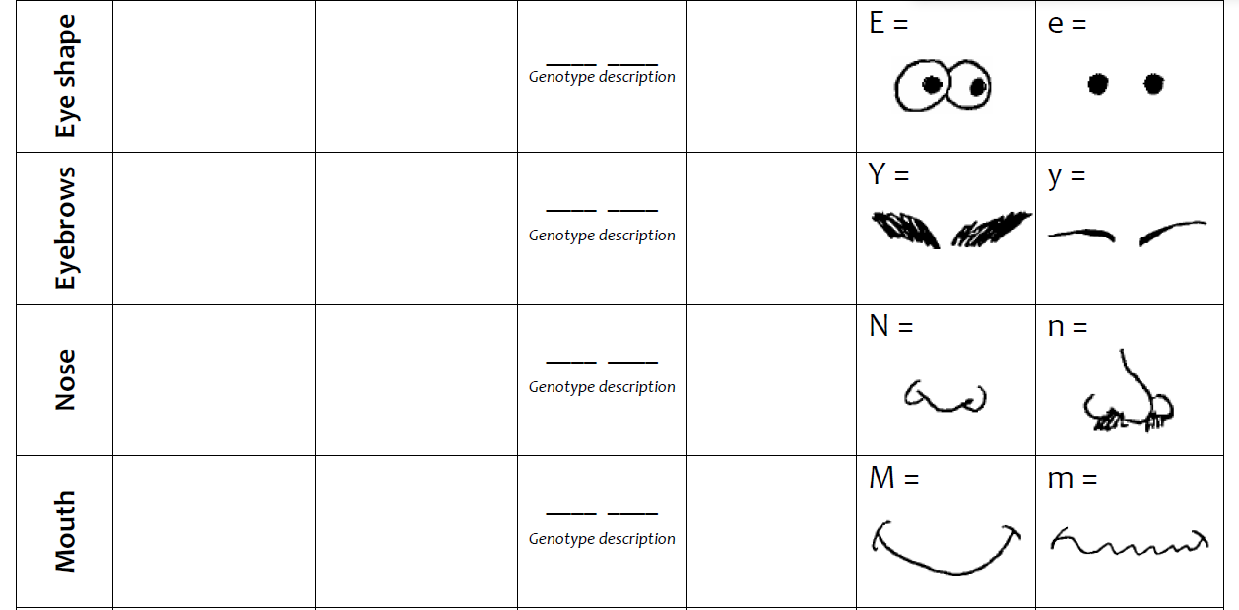
Genetics of a Cartoon Character (You Do)

Slide 25
Genetics Study Guide (closing)
How is your gender determined?
X or Y chromosome given by father

Slide 26
Genetics Study Guide (closing)
What is the function of a chromosome?
It contains the cell’s DNA and controls cell processes.

Slide 27
Genetics Study Guide (closing)
What happens when there is a simple change in a cell’s DNA?
A mutation

Slide 28
Genetics Study Guide (closing)
Where is the information coded that is passed down or inherited from our parents?
chromosomes

Slide 29
Genetics Study Guide (closing)
12. What part of the DNA is responsible for the inheritance of a trait?
gene

Slide 30
Genetics Study Guide (closing)
Where is DNA found in a eukaryotic cell?
nucleus

Slide 31
Cornell Notes
Law of Segregation
Vimeo Video
Law of Independent Assortment
Vimeo video

