Slide 1
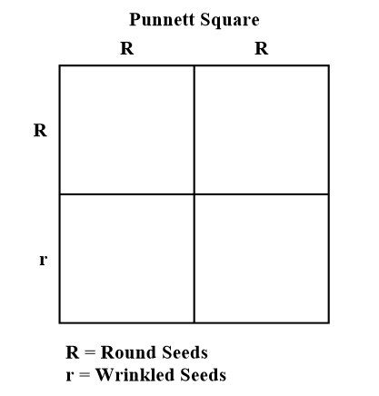
Warm Up
Pea plants have seeds that are either round or wrinkled. In this cross, what will be the phenotypic ratio of the offspring?
A. 50% RR and 50% Rr
B. 25% RR, 50% Rr, and 25% rr
C. 50% round seeds and 50% wrinkled seeds
D. 100% round seeds

Slide 2
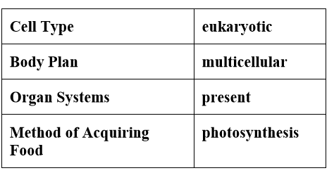
Warm Up
Which kingdom is represented with the highlighted characteristics?
A. Fungi
B. Plantae
C. Protista
D. Animalia

Slide 3
Warm Up
A. Genetic screening results could be used to determine inheritance patterns in families.
B. The likelihood of a child contracting an inheritable disease could be predicted by genetic screening.
C. A doctor could combine a patient’s current symptoms with genetic screening results to diagnose and treat the patient.
D. Insurance companies could drop a patient’s medical coverage based on potential medical issues projected by genetic screening.
Genetic screening is a procedure where a person’s DNA is analyzed to identify a genetic predisposition to lethal diseases. One advantage of genetic screening is that it allows doctors to prevent and treat diseases before patients have symptoms.
Which of the following is a disadvantage of genetic screening?

Slide 4
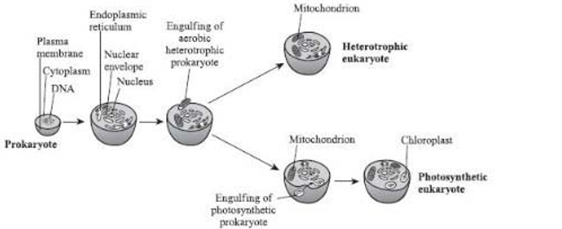
The diagram below shows a proposed theory of the origin of eukaryotic cells, called endosymbiosis.
Which of the following explains why cells that contained mitochondria-like organelles had an evolutionary advantage?
A. They were able to photosynthesize
B. They had more DNA
C. They were able to make more use of available energy
D. They were immune to bacterial invasion.

Slide 5
Warm Up
The genetic disorder trisomy 21 (Down syndrome) is caused by what genetic event?
A. crossing-over
B. Nondisjunction
C. base pair substitution
D. frame-shift location

Slide 6
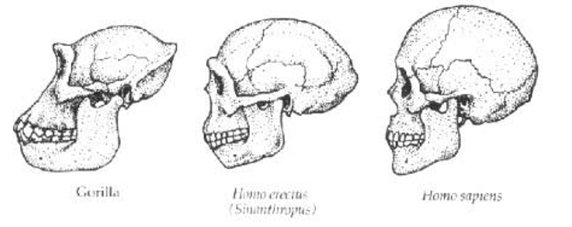
Scientists have found evidence that about 2.4 million years ago a gene regulating jaw muscles mutated and may have led to the more graceful human jaw we see today. The diagram below shows the skulls of 3 hominid species
Which statement below most closely explains the link between jaw size and hominid evolution?
A. The jaws of hominids evolved to be smaller and less protruding over time.
B. The jaws of hominids evolved to be larger and more protruding over time.
C. There appears to be no change in the jaws of hominids over time.
D. The jaws of hominids changed over time due to a change in brain size.

Slide 7
Why do cells need both tRNA and mRNA?
A. Only tRNA bends into a shape that can carry specific amino acids
B. Only mRNA can be used to repair mistakes in the DNA sequence.
C. The tRNA in used on the ribosomes and the mRNA is used in the nucleus.
D. The mRNA brings information to the nucleus for the tRNA to use

Slide 8
Mutations within a DNA sequence are:
natural processes that produce genetic diversity
natural processes that always affect the phenotype
C. unnatural processes that always affect the phenotype
D. unnatural processes that are harmful to genetic diversity.

Slide 9
Warm Up
A. the X chromosome
B. the Y chromosome
C. both the X and Y chromosomes
D. either the X or Y chromosome
The gene for red/green colorblindness in humans is recessive and primarily affects males. It must be located on _____

Slide 10
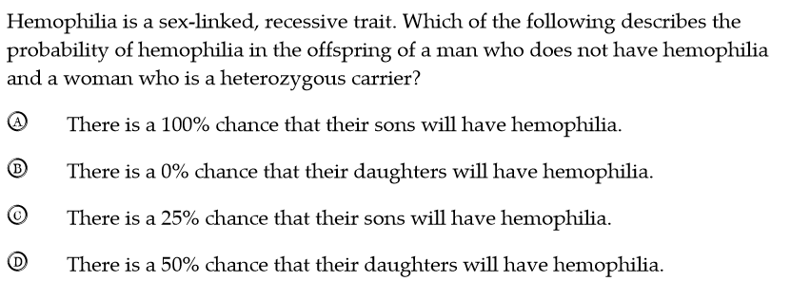
Warm UP

Slide 11
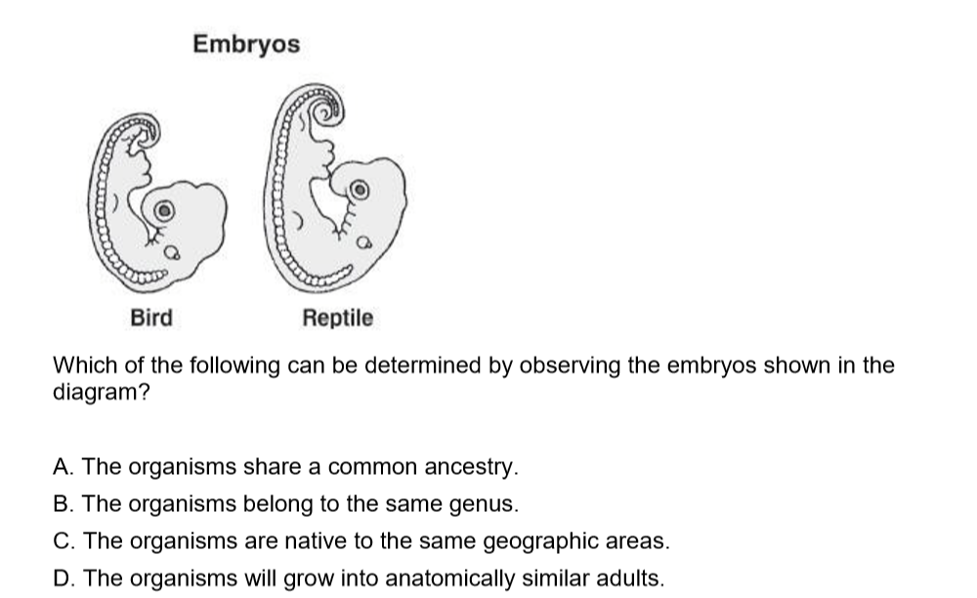

Slide 12
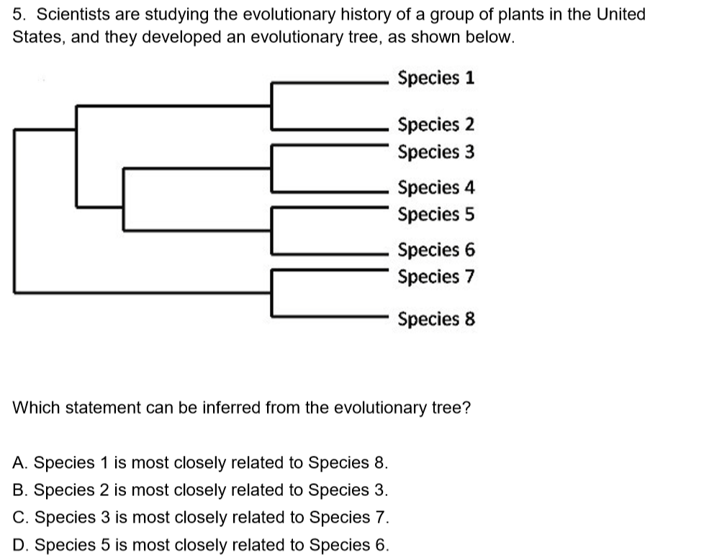

Slide 13
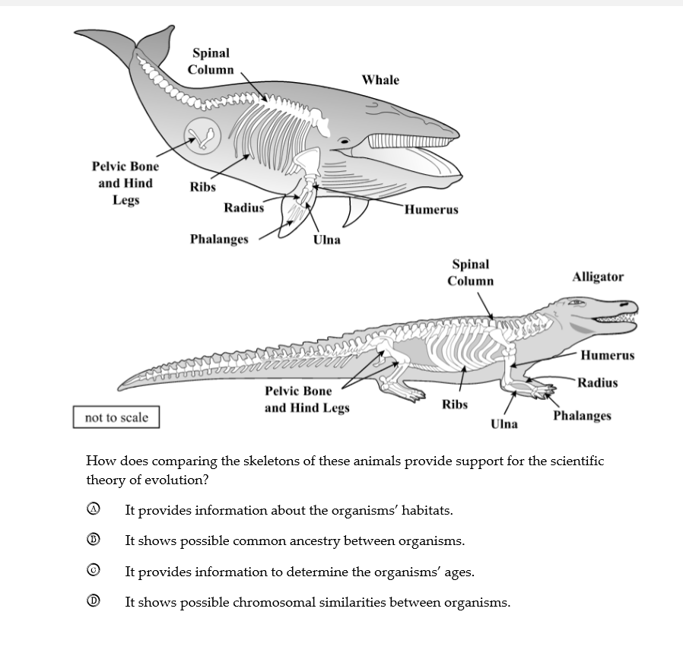

Slide 14
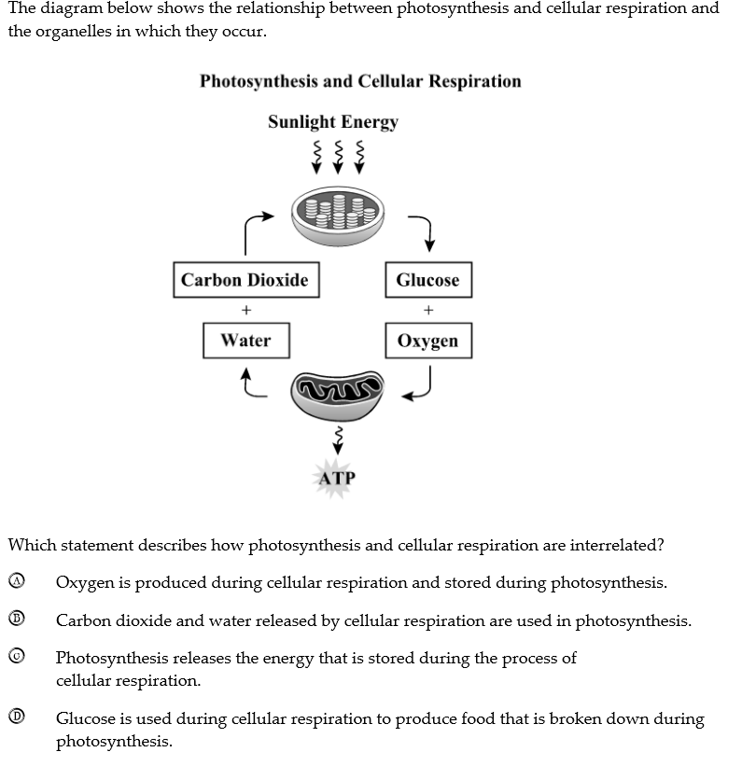

Slide 15
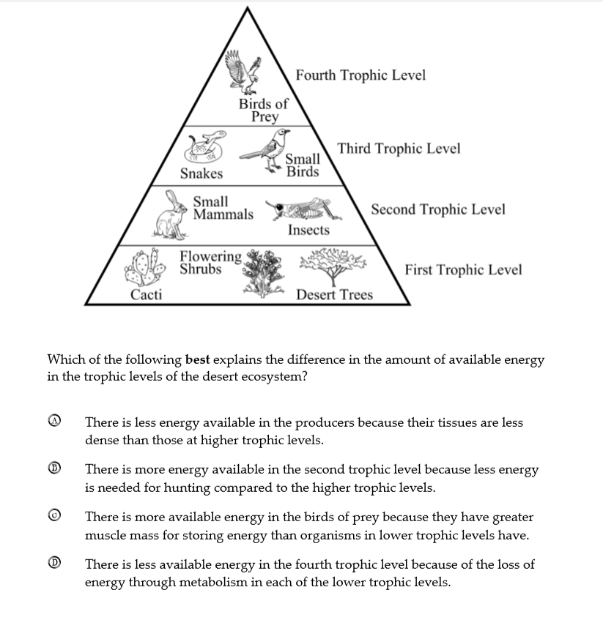

Slide 16
Warm Up
Before mitosis begins, which happens before the nucleus starts dividing?
A. The cytoplasm separates.
B. The DNA replicates.
C. The sister chromatids separate.
D. The homologous chromosomes cross over.

Slide 17
Warm Up
Which statement best describes the relationship that exists among proteins, DNA, and cells?
A. Proteins combine to produce cells, which produce DNA.
B. Proteins are made up of DNA, which determines the cells that are produced.
C. DNA is made up of proteins, which tell a cell how to function.
D. Cells contain DNA, which controls the production of proteins

Slide 18
Why is meiosis important for sexual reproduction?
A. It allows the zygote formed from fertilization to have triple the chromosome number of the organism.
B. It allows gametes to have twice the original number of chromosomes of the organism.
C. It allows gametes to have half the original number of chromosomes of the organism.
D. It allows the zygote formed from fertilization to have half the original number of chromosomes of the organism.

Slide 19
Which process produces the most variation within a species?
A. asexual reproduction
B. sexual reproduction
C. mitosis
D. cloning

Slide 20
Which technique would most likely be used by forensic scientists?
A. gene cloning
B. gene therapy
C. DNA fingerprinting
D. karyotyping

Slide 21
What process best explains how a nerve cell and a muscle cell can both develop from the same fertilized egg?
A. differentiation
B. natural selection
C. selective breeding
D. genetic engineering

Slide 22
What will most likely be the result if all of the mitochondria are removed from a plant cell?
A. It will be unable to carry out respiration.
B. It will lose water through osmosis.
C. It will break down the ribosomes in the cell.
D. It will be unable to photosynthesize.

Slide 23
What is the diploid chromosome number in a human body cell?
23
32
44
46

Slide 24
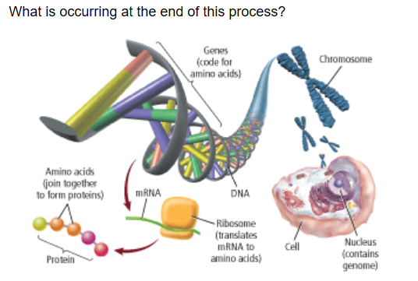
A. protein synthesis
B. Cloning
C. DNA fingerprinting
D. Bioinformatics

Slide 25
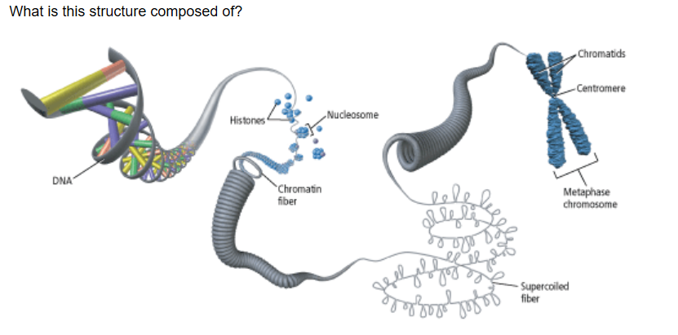
A. histones without DNA
B. DNA coiled around histones
C. DNA without histones
D. messenger RNA

Slide 26
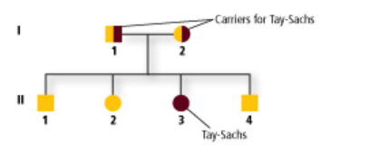
How is it possible that one of the children in this pedigree expresses Tay-Sachs?
A. carrier parents passed both recessive alleles
B. parents expressed the disease
C. child was infected by siblings
D. child is heterozygous dominant

Slide 27
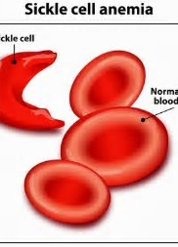
Why is sickle-cell disease a codominant genetic condition?
A. Both alleles are expressed in the homozygous condition.
B. No alleles are expressed in the heterozygous condition.
C. Both alleles are expressed in the heterozygous condition.
D. An intermediate phenotype is expressed.

Slide 28
Why is sickle-cell disease a codominant genetic condition?
A. Both alleles are expressed in the homozygous condition.
B. No alleles are expressed in the heterozygous condition.
C. Both alleles are expressed in the heterozygous condition.
D. An intermediate phenotype is expressed.

Slide 29
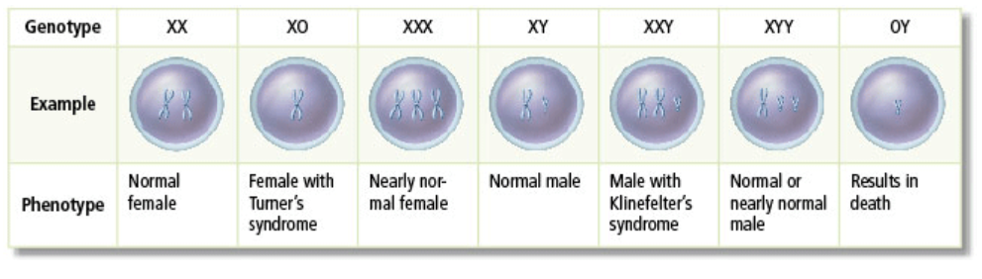
What does this table show examples of?
A. nondisjunction in sex chromosomes
B. karyotypes for sex chromosomes
C. pedigree for diseases
D. telomeres

Slide 30
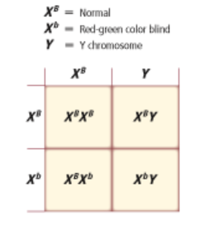
Study this Punnett square. Why does the father not have color blindness?
A)
A. He does not have the recessive allele.
B. He has a Y chromosome.
C. He has two recessive alleles.
D. He is missing the X chromosome.

Slide 31
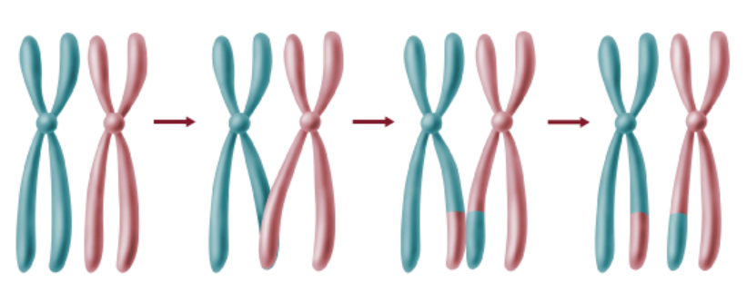
What process is shown here?
A. interphase
B. zygote formation
C. exchange of chromosomal segments
D. asexual reproduction

Slide 32
What is produced by the crossing over and independent assortment of genes?
A. X chromosomes
B. genetic recombination
C. Y chromosomes
D. allele

Slide 33
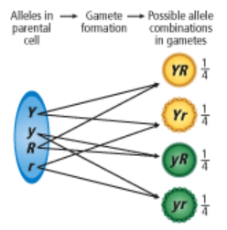
What conclusion can be made from this figure about the Law of Segregation
A. alleles are not allowed to combine
B. random assortment results in eight possible gametes
C. random assortment results in four possible gametes
D. gametes are not allowed to form

Slide 34
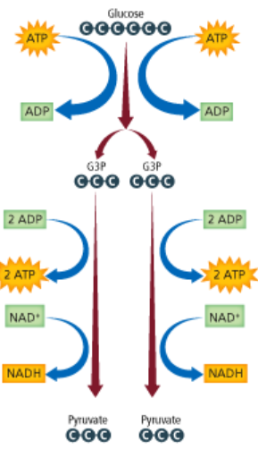
What important function of cellular respiration occurs in the process shown?
A. glycolysis
B. aerobic respiration
C. electron transport
D. citric acid production

Slide 35
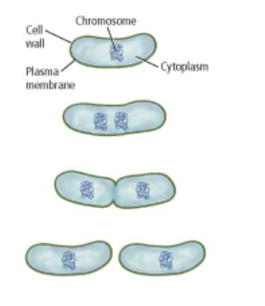
What process is shown here?
A. sexual reproduction
B. zygote formation
C. binary fission
D. singular fusion
What results from the process shown here?
A. genetically different cells
B. genetically identical cells
C. two cells lacking cell walls
D. two cells lacking cytoplasm

