Slide 1
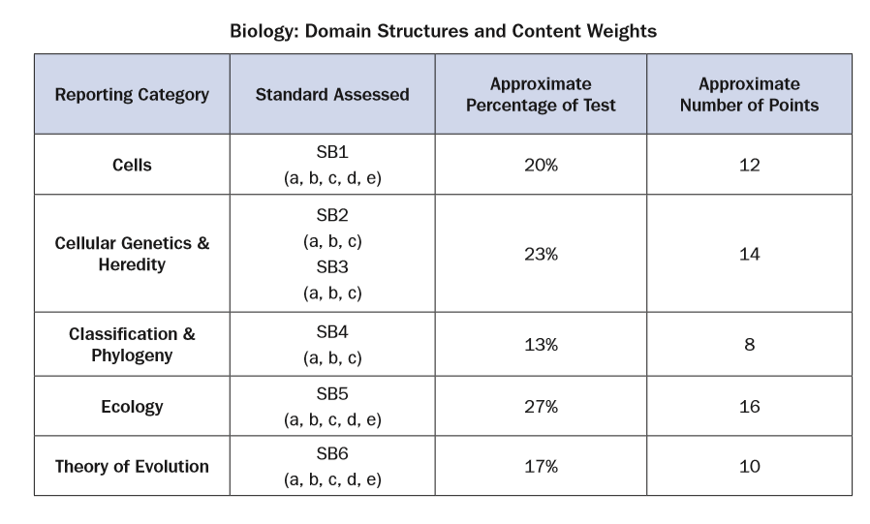
Biology EOC Friday 12/15/17

Slide 2
Warm Up 1. 2. 3. 4. 5. 6. 7. 8. 9.

Slide 3
Warm Up 1. c 2. c 3. a 4. a 5. b 6. c 7. d 8. c 9. a

Slide 4
Warm Up 10. 11 12. 13. 14. 15.

Slide 5
Warm Up 10. c 11. b 12. b 13. b 14. b 15. a

Slide 6
Questions

Slide 7
Questions

Slide 8
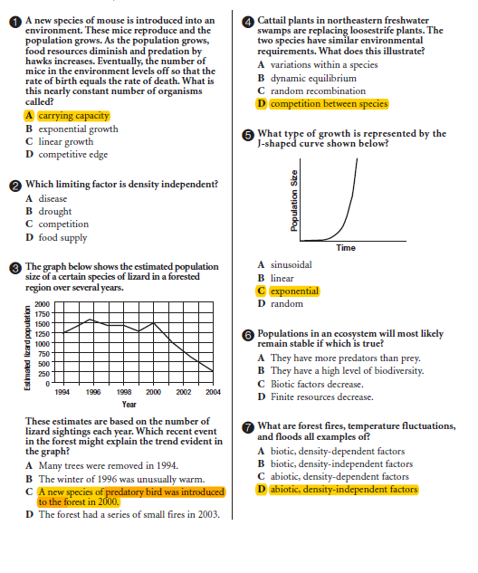
Questions

Slide 9
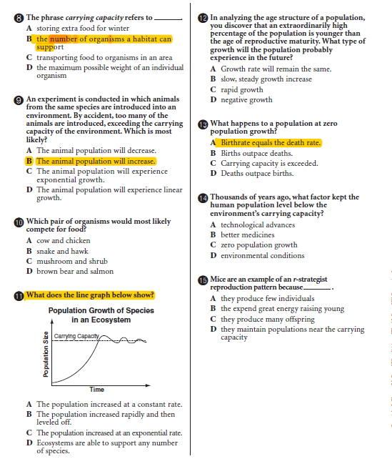
Questions

Slide 10
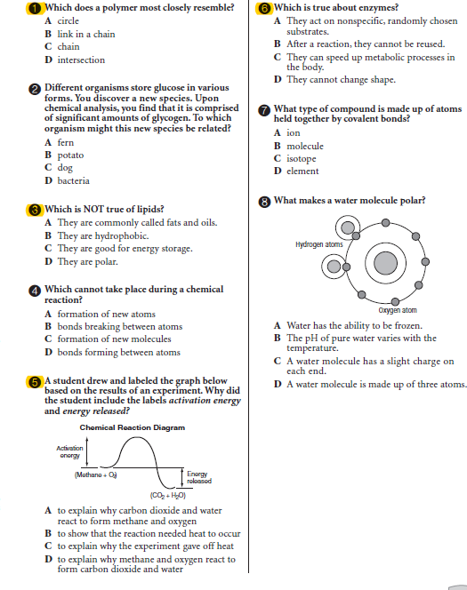
Questions chapter 6
1.
3.
5.
6.

Slide 11
Questions chapter 6
1. b
3. d
5. d
6. c

Slide 12
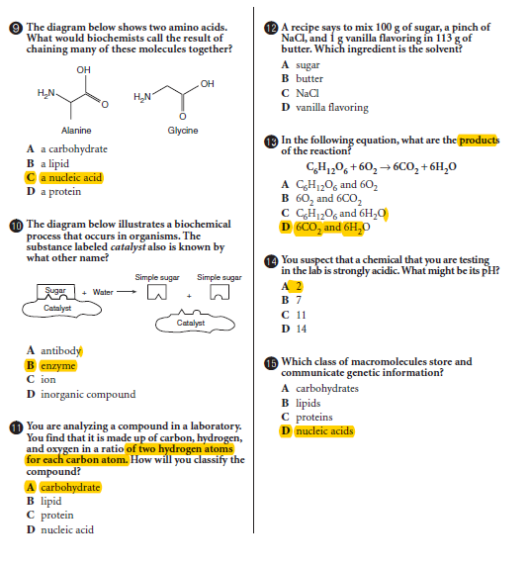
Questions chapter 6

Slide 14
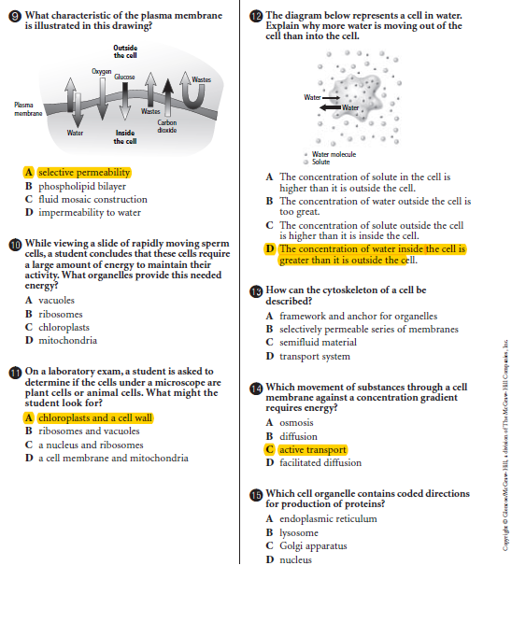

Slide 15
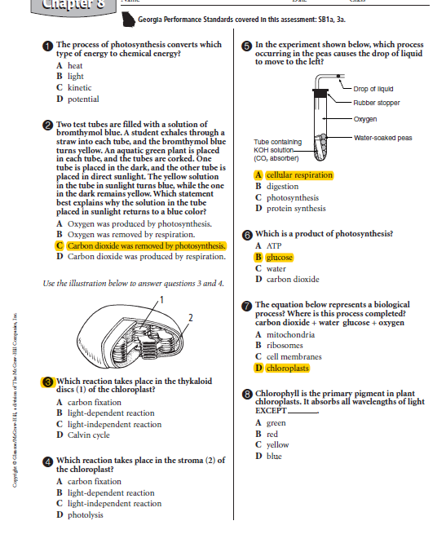

Slide 16
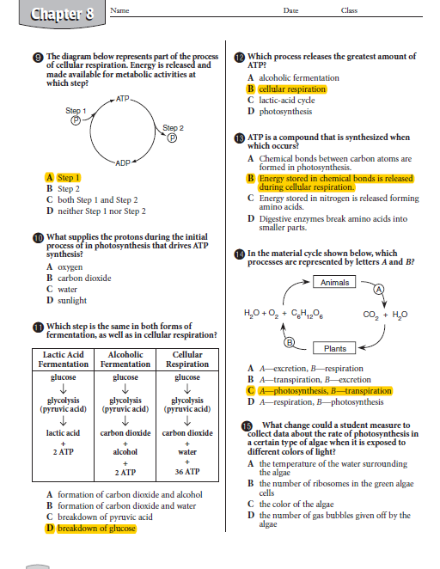

Slide 17
Compare/Contrast Active to Passive Transport
both
Active transport
Passive transport

Slide 18
Compare/Contrast Active to Passive Transport
Both
Transport,
Move molecules through cell membrane
Active transport
Low to high concentration
Larger molecules
Energy involved
Ex. Endocytosis and exocytosis
Passive transport
High to low concentration
Small molecules
no energy involved
Ex. Diffusion and osmosis

Slide 19
Warm UP
Prokaryote
Eukaryote
Compare/Contrast: Prokaryotic and Eukaryotic Cells

Slide 20
Warm UP
Prokaryote
Unicellular
No Nucleus
No Membrane bound Organelles
Ex: bacteria
Eukaryote
Unicellular & multicellular
True Nucleus
Membrane bound Organelles
Ex: plants, animals, protists, fungi
Both
Cell membrane
Ribosomes
Cytoplasm
DNA
Compare and Contrast: Prokaryotic and Eukaryotic Cells

Slide 21
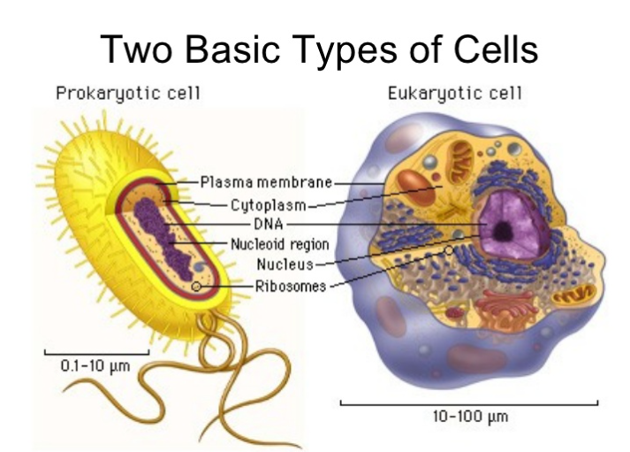
All living thing are made of cells
2 types of Cells:
Prokaryotic
Eukaryotic
Levels of Organization
Atoms ---- molecules (macromolecules)-----Cells----Tissues----Organs----Systems

Slide 22
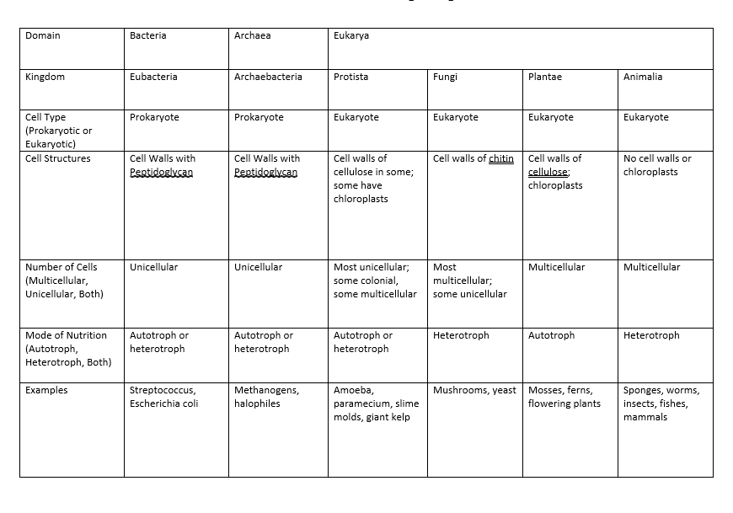
Reflection: Classification of Living Things

Slide 23
Characteristics of Life
All living things are:
Made of Cells
Are Organized
Maintain HOMEOSTASIS
Grow and Develop
Reproduce
Respond to Stimuli
Adapt/Evolve
Reflection

Slide 24
Characteristics of Life
All living things are:
Made of Cells (Pro. Vs. Euk.)
Are Organized (parts of cell)
Maintain HOMEOSTASIS
Grow and Develop
Reproduce
Respond to Stimuli
Adapt/Evolve
Reflection

Slide 25
Cells
SB1. Obtain, evaluate, and communicate information to analyze the nature of the relationships between structures and functions in living cells.
a. Construct an explanation of how cell structures and organelles (including nucleus, cytoplasm, cell membrane, cell wall, chloroplasts, lysosome, Golgi, endoplasmic reticulum, vacuoles, ribosomes, and mitochondria) interact as a system to maintain homeostasis.
Comparison of Organelles
Function and structure of organelles
Prokaryote vs. Eukaryote

Slide 26
Characteristics of Life
All living things are:
Made of Cells (Pro. Vs. Euk.)
Are Organized (parts of cell)
Maintain HOMEOSTASIS
Grow and Develop
Reproduce
Respond to Stimuli
Adapt/Evolve
Reflection

Slide 27
Cell Parts and Functions
Mitochondria
Vacuole
Cytoplasm
Nucleolus
Chromosome
Chromatin
Rough ER
Centrioles
Cell wall
Golgi Complex
Cell Membrane
Ribosomes
Chloroplast
a. Cell Membrane
b. Chloroplasts
c. Cell Wall
d. Vacuole
e. Mitochondria
g. Chromosomes
g. Centrioles
h. Golgi complex
Chloroplasts
Large Central Vacuole
Cell Wall
Cytoplasm

Slide 28
Characteristics of Life
All living things are:
Made of Cells (Pro. Vs. Euk.)
Are Organized (parts of cell)
Maintain HOMEOSTASIS
Grow and Develop
Reproduce
Respond to Stimuli
Adapt/Evolve
a. Construct an explanation of how cell structures and organelles (including nucleus, cytoplasm, cell membrane, cell wall, chloroplasts, lysosome, Golgi, endoplasmic reticulum, vacuoles, ribosomes, and mitochondria) interact as a system to maintain homeostasis.

Slide 29
Organized: Monomer vs. Polymer
All living things are “organized”
There are 4 building blocks of living things: Carbohydrates, Lipids, Proteins, Nucleic Acids
c . Construct arguments supported by evidence to relate the structure of macromolecules (carbohydrates, proteins, lipids, and nucleic acids) to their interactions in carrying out cellular processes. (Clarification statement: The function of proteins as enzymes is limited to a conceptual understanding.)
Carbohydrates---> Cellular Respiration, Photosynthesis
Lipids--->
Proteins-----> Protein Synthesis,
Nucleic Acids----> DNA Replication, Mitosis/Meiosis, Protein Synthesis
Macromolecule (Polymer) | Carbohydrates | Lipids | Proteins | Nucleic Acids
Monomer | Monosaccharide | 3 fatty acids and 1 glycerol | Amino acids | nucleotides
Function | Quick energy | Stored energy | Structure, carrier, reactions | Genetic instructions
Cellular Process | Cellular Respiration Photosynthesis | * CR, hormones, | Protein synthesis, (traits) | Cellular reproduction, protein synthesis

Slide 30
Cell Organelle Comparison
Working with your group identify the relationship with paired organelles or cell structures
This will be an explanation of how cell structures and organelles maintain HOMEOSTASIS (stable internal conditions)

Slide 32
Characteristics of Life
b. Develop and use models to explain the role of cellular reproduction (including binary fission, mitosis, and meiosis) in maintaining genetic continuity.
⇨ Mitosis/Meiosis Webquest
⇨ Cellular Reproduction Comparison (graphic organizer
All living things are:
Made of Cells (Pro. Vs. Euk.)
Are Organized (parts of cell)
Maintain HOMEOSTASIS
Grow and Develop
Reproduce
Respond to Stimuli
Adapt/Evolve

Slide 33
b. Develop and use models to explain the role of cellular reproduction (including binary fission, mitosis, and meiosis) in maintaining genetic continuity.
Mitosis
Body cells
Asexual reproduction
Identical to parent
No genetic diversity
Growth & Repair
Meiosis
Sex Cells
Sexual reproduction
Different from parent
“genetic variation”
(crossing over”
Make Gametes
2n-n
Binary Fission
Bacteria
Asexual reproduction
Identical to parent
No genetic diversity
Reproduction
2n---2n
Mitosis/Meiosis Webquest
Cellular Reproduction Comparison (graphic organizer)

