Slide 1
Warm Up
Identify the Four Macromolecules and their Functions

Slide 2
Warm Up: Identify the Four Macromolecules and their Functions
Carbohydrates- Quick or “ready” energy
Proteins- Structure of cell and chemical reactions
Lipids- Stored energy, insulation
Nucleic Acid- transmit genetic information

Slide 3
Macromolecules Review Frayer Model
SB1.c
Identify the function of the four major macromolecules (carbohydrates, lipids, proteins and nucleic acids)

Slide 4
Carbohydrates

Slide 5
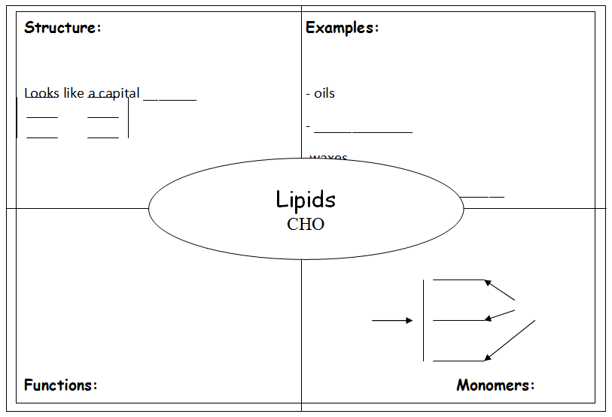
Lipids

Slide 6
Protein

Slide 7
Nucleic Acid

Slide 8
Check for Understanding
Proteins are polymers of
a. Fatty acids
b. Amino acids
c. monosaccharides
d. Nucleic acids

Slide 9
Check for Understanding
Which of the following is NOT an organic molecule?
a. Carbohydrate
b. Ice
c. Lipid
d. Nucleic acid

